Slide 1
Django A python based web

Slide 2
Major 3 Parts of Web Applications
Front End
Middle Ware
Back End
Define or
Presentation layer
Front-end & Back-end
Part between information
Data stored & Executes
Code

Slide 3

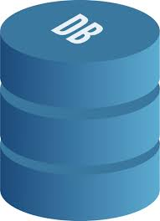


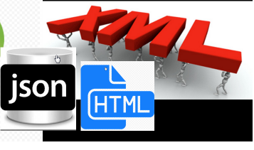

Python web framework functionality
Format like HTML, XML & JSON
Best security with Secure Other Attacks
Session storage & improvement
Database Control
URL
routing

Slide 4
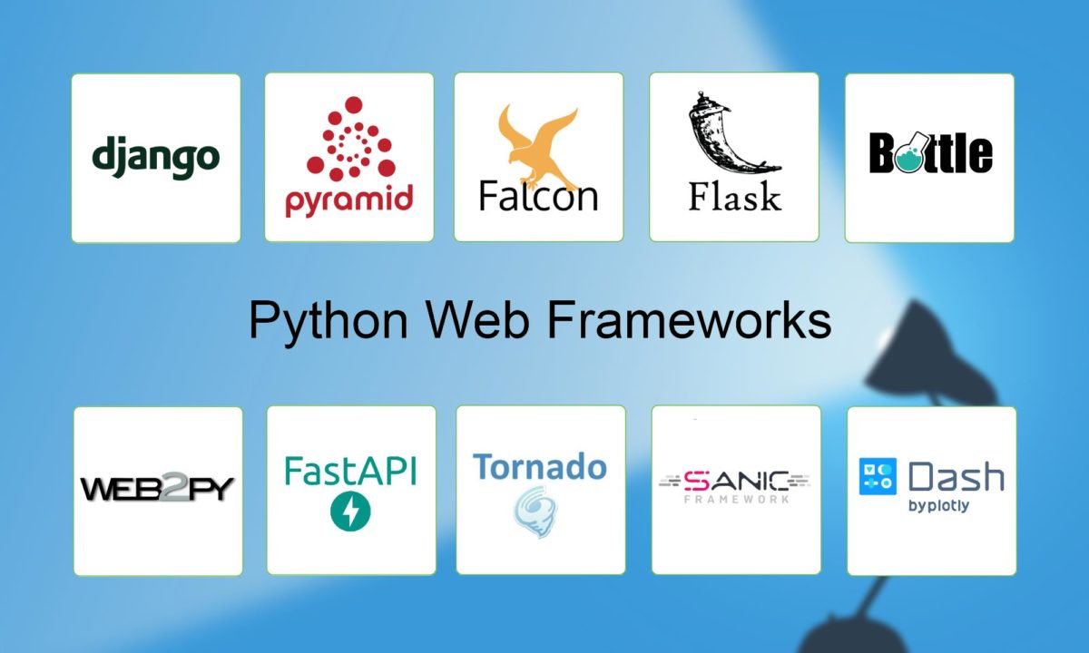
Popular Python Web Frameworks
Ref : Activestate.com

Slide 5
What is WSGI ?
"WSGI is the Web Server Gateway Interface. It is a specification for web servers and application servers to communicate with web applications (though it can also be used for more than that). It is a Python standard, described in detail in PEP 333."
Provides a way for reusable web components to easily work together through this specification
Also allows you to easily deploy web application that follow

Slide 6
Pyramid
database backend agnostic but has supporting packages for sqlalchemy, zodb, mongodb.
no authentication policy built-in but has supported add-ons
great authorization policy
small footprint, fast, well tested and very well documented
VERY pluggable framework
URL pattern can use traversal and routes
"no opinion"
add-ons can be described as "opinions" for the framework.
demonstrating "khufu" opinion(SQLAlchemy, Jinja2, traversal)
built using zope technologies with the idea of rewriting all
the bad of zope

Slide 7
web2py
FULL stack
built-in ORM
inspired by ruby on rails(so modules and method name map to urls)
admin interface with support of TTW development
coding by convention
not very pythonic
lots of "magic" going on

Slide 8
Flask
micro framework
no built-in ORM support
uses routes
very simple
fast development
not as robust tools

Slide 9
Bottle
Micro framework
1 file for whole thing
not a very good built-in templating engine
no built-in ORM
initial look will seem a lot like flask

Slide 10
Why Django?
Django offers lots of features and is a new emerging technology of the future. Since it is based on python, which itself is a very powerful language and also is going to be used in the future extensively, therefore, it is worthwhile to learn Django.
One of the World’s Best Software Community
Django has Evolved Over Time
Django has Lots of Pre-Made Apps
Open-Source Technology
Notes:
Django has Evolved Over Time
Since the release of Django, it is having a lot of features and still, Django continues its journey and has been in the industry for more than a decade. It’s a fairly long time and has several releases in that course of time. Django has fixed lots of security issues and has introduced lots of features, thus this time period accounts for the stability of Django and also that the technology is powerful enough to stay in the industry.
ii. Open-Source Technology
Django is an open source technology and that sometimes means that the documents are not given that much priority, but that’s not the case with Django. Django from the release in 2005 has excellent documentation and it’s still well maintained that means at the time of release this was the only framework with great documentation.
iii. One of the World’s Best Software Community
Django framework community is one of the best communities out there as they support all the projects and resolve all the queries they can in a supporting manner. That is one of the reasons that the Django community is growing at a fast pace and therefore more and more people are shifting towards Django and it will be used more extensively in the future. This is the reason, why it is a great addition to your resume.
iv. Django has Lots of Pre-Made Apps
Since Django has a great community. It also has lots of packages which can solve your problems with ease. These packages can be easily found with its well-maintained documentation, and thus resulting in rapid development.

Slide 11
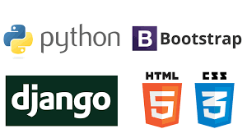
What is Django ?
Django is a high-level Python web framework that enables rapid development of secure and maintainable websites. Built by experienced developers, Django takes care of much of the hassle of web development, so you can focus on writing your app without needing to reinvent the wheel.

Slide 12
Features
Django has its own naming system for all functions and components (e.g., HTTP responses are called “views”). It also has an admin panel, which is deemed easier to work and other technical features, including:
Simple syntax;
Its own web server;
MVC (Model-View-Controller) core architecture;
“Batteries included” (comes with all the essentials needed to solve solving common cases);
An ORM (Object Relational Mapper);
HTTP libraries;
Middleware support; and
A Python unit test framework.

Slide 13
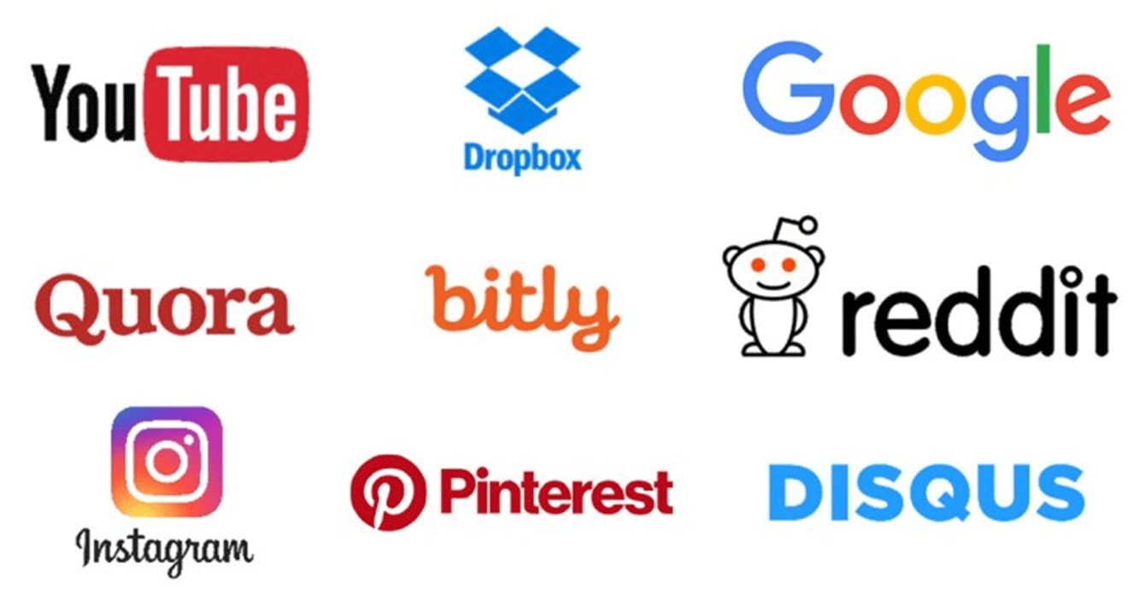
Companies That use Django
Notes:
Instagram: Another popular social network that deals with a great deal of media data and user interactions. Django enables the functionality that makes the web application work seamlessly, add new features, and fix issues in no time.
Spotify: A large media library with huge volume of information that allows users to listen to music free of charge or on an ad-free subscription basis. On the technical side of things, Spotify also uses machine learning, where Python is one of the best choices. The creators chose to combine it with the Django framework.
The Washington Post: It’s no wonder that The Washington Post would use Django to handle its heavy traffic, since the framework itself was created to power an online newspaper. Several other online periodicals also use Django.
Dropbox: A cloud technology for file storage requires high-performance functionality. Django provides Dropbox with the tools it needs to provide sharing and synchronization, as well as scalability.
Mozilla: One of the most popular web browsers, and another web application that switched from PHP to Python, and thus to Django. Now, it is better able to handle huge traffic and API hits.
NASA: They use Django for some of the functional elements that require the most reliability. Their website is not as popular as Instagram, for example, yet it handles high-resolution imagery and an average of 2 million views per month.
Pinterest: This platform has well over 250 million active users per month, handles huge volumes of media data, and yet manages to sustain its user-friendly interface. Thanks to its open-source framework, the creators were able to modify it to suit their needs.
Reddit: What’s the first site go to for social news and discussions? For many people, it’s Reddit — a web content platform where people ask questions, share opinions, and where posts are promoted based on a rating system. Reddit relies on Django for many of its functional capabilities, like servicing heavy user traffic.

Slide 14
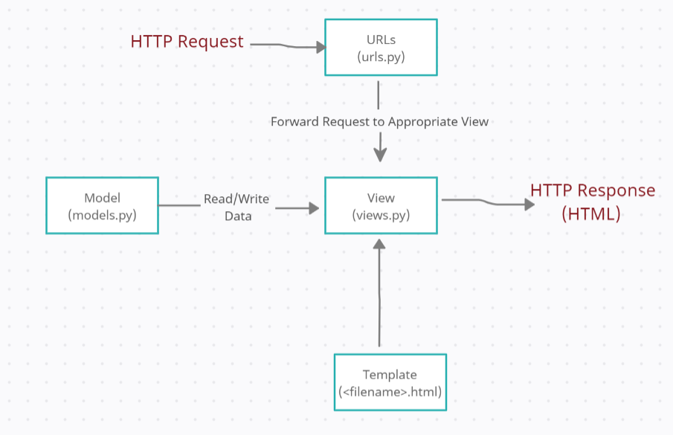
Django Structural Block Diagram

Slide 15
Django Structure
URLs: While it is possible to process requests from every single URL via a single function, it is much more maintainable to write a separate view function to handle each resource. A URL mapper is used to redirect HTTP requests to the appropriate view based on the request URL. The URL mapper can also match particular patterns of strings or digits that appear in a URL and pass these to a view function as data.
View: A view is a request handler function, which receives HTTP requests and returns HTTP responses. Views access the data needed to satisfy requests via models, and delegate the formatting of the response to templates.
Models: Models are Python objects that define the structure of an application's data, and provide mechanisms to manage (add, modify, delete) and query records in the database.
Templates: A template is a text file defining the structure or layout of a file (such as an HTML page), with placeholders used to represent actual content. A view can dynamically create an HTML page using an HTML template, populating it with data from a model. A template can be used to define the structure of any type of file; it doesn't have to be HTML!

Slide 16
Creating First Project
You are working with PyCharm version 2016.1 or later. If you still do not have PyCharm, download it from here. To install PyCharm, follow the instructions, depending on your platform.
You have at least one Python interpreter properly installed on your computer. You can download an interpreter from here.
You have Django package installed.

Slide 17
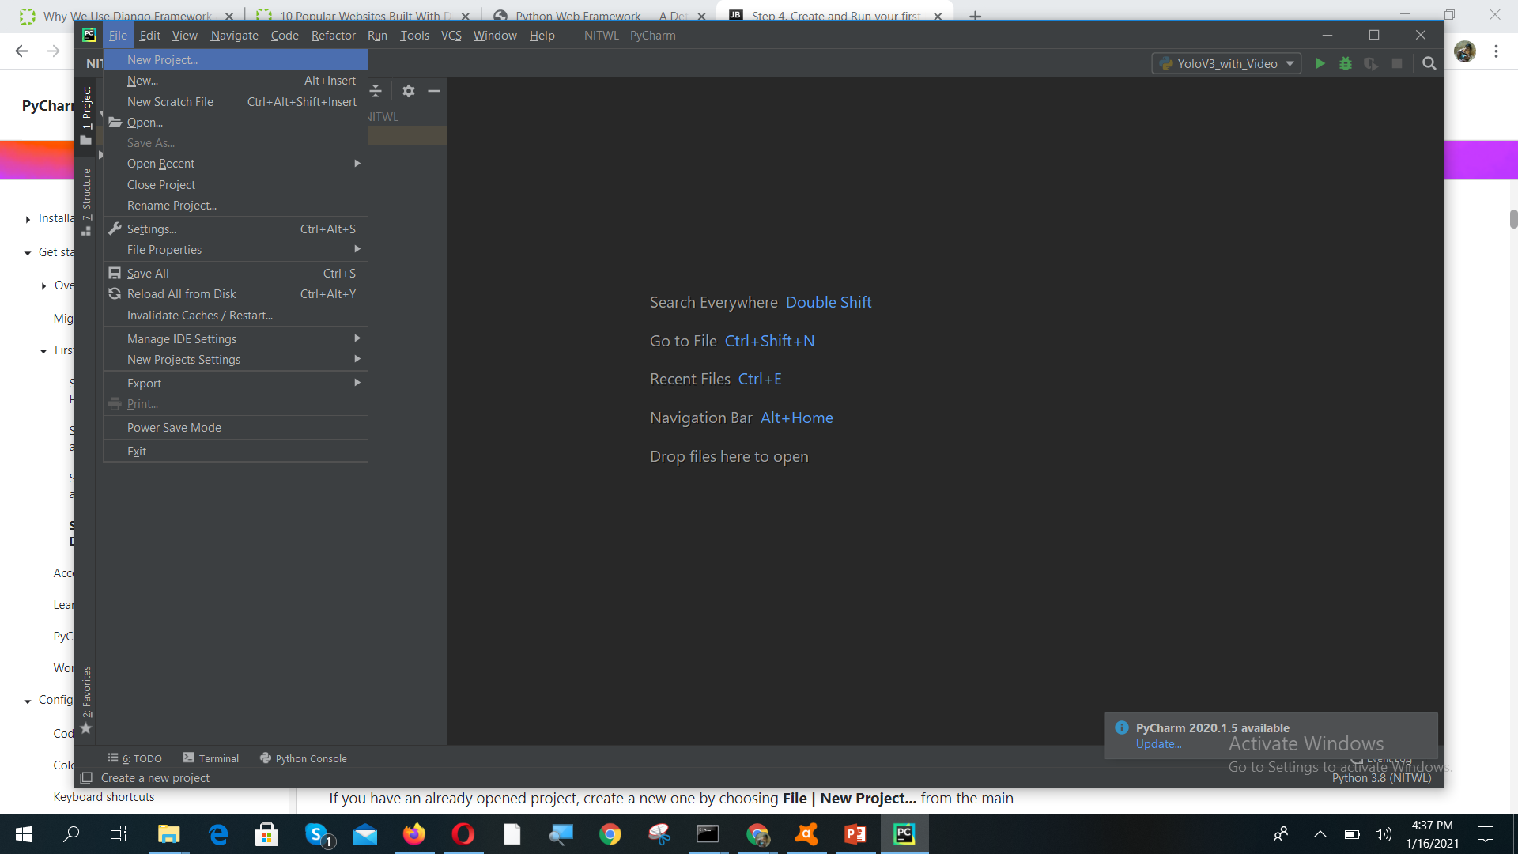
Create a project

Slide 18
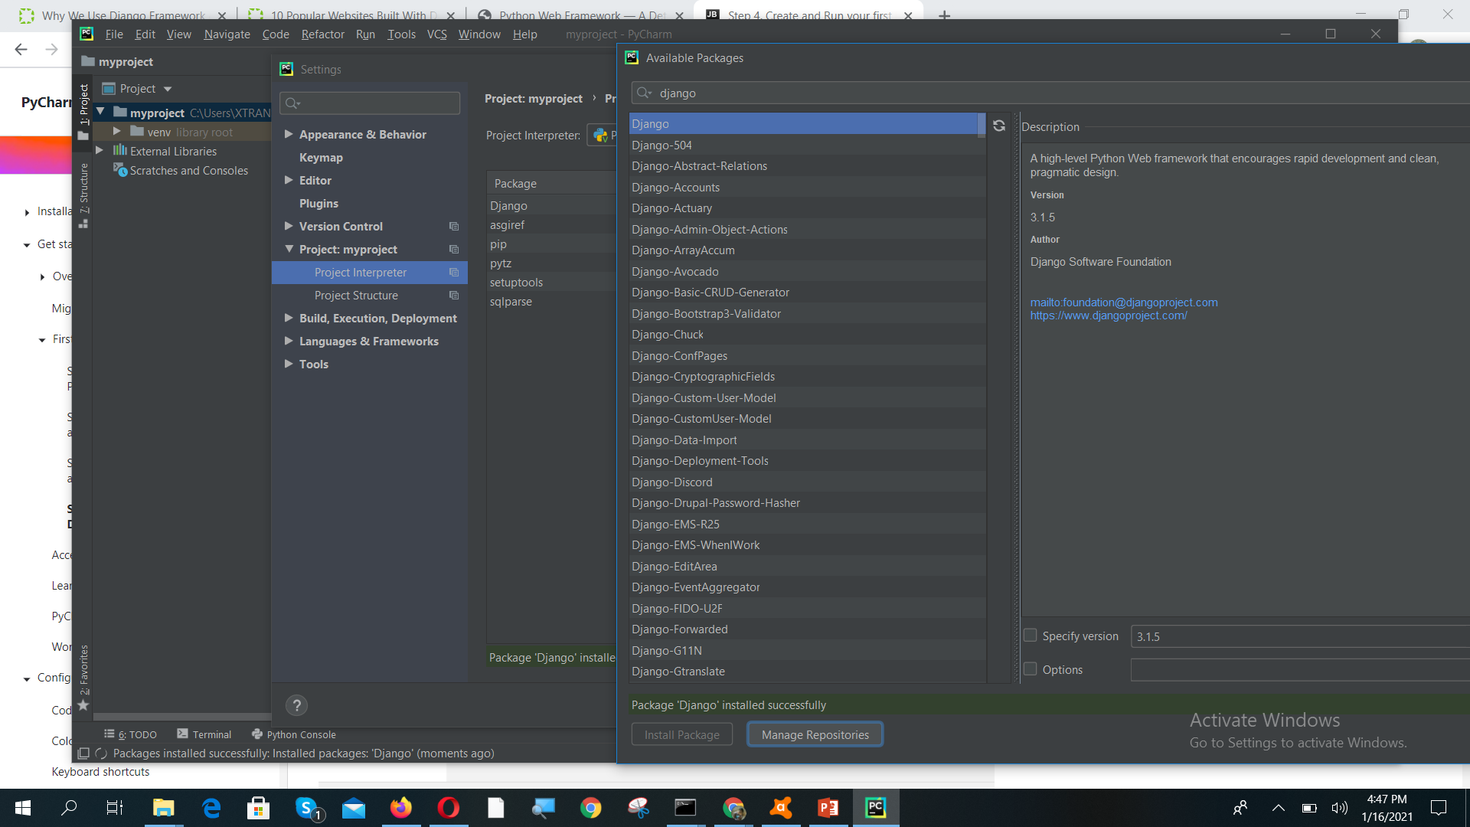
File → settings then install django

Slide 19
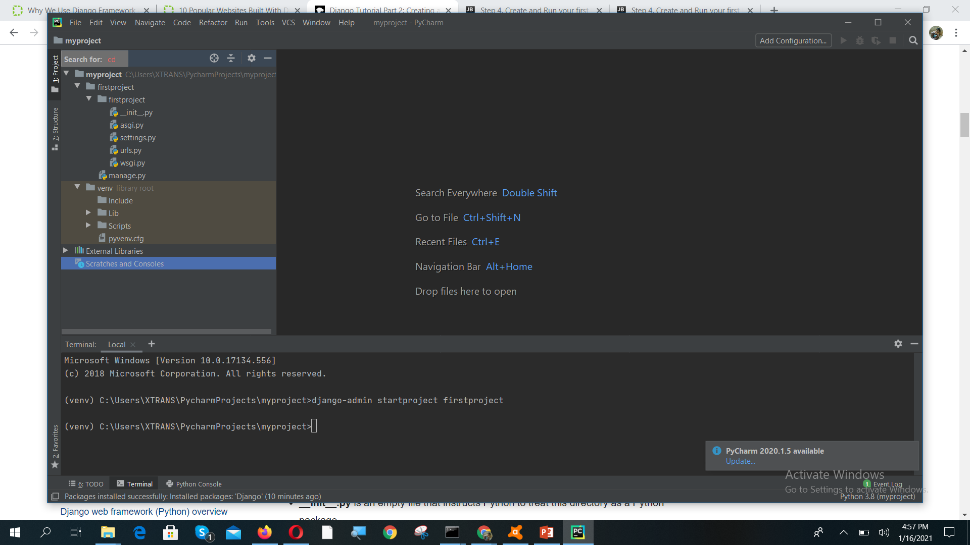
Create Django project

Slide 20
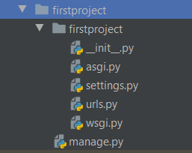
Folder Structure
__init__.py is an empty file that instructs Python to treat this directory as a Python package.
settings.py contains all the website settings, including registering any applications we create, the location of our static files, database configuration details, etc.
urls.py defines the site URL-to-view mappings. While this could contain all the URL mapping code, it is more common to delegate some of the mappings to particular applications, as you'll see later.
wsgi.py is used to help your Django application communicate with the webserver. You can treat this as boilerplate.
asgi.py is a standard for Python asynchronous web apps and servers to communicate with each other. ASGI is the asynchronous successor to WSGI and provides a standard for both asynchronous and synchronous Python apps (whereas WSGI provided a standard for synchronous apps only). It is backward-compatible with WSGI and supports multiple servers and application frameworks.
The manage.py script is used to create applications, work with databases, and start the development web server.

Slide 21
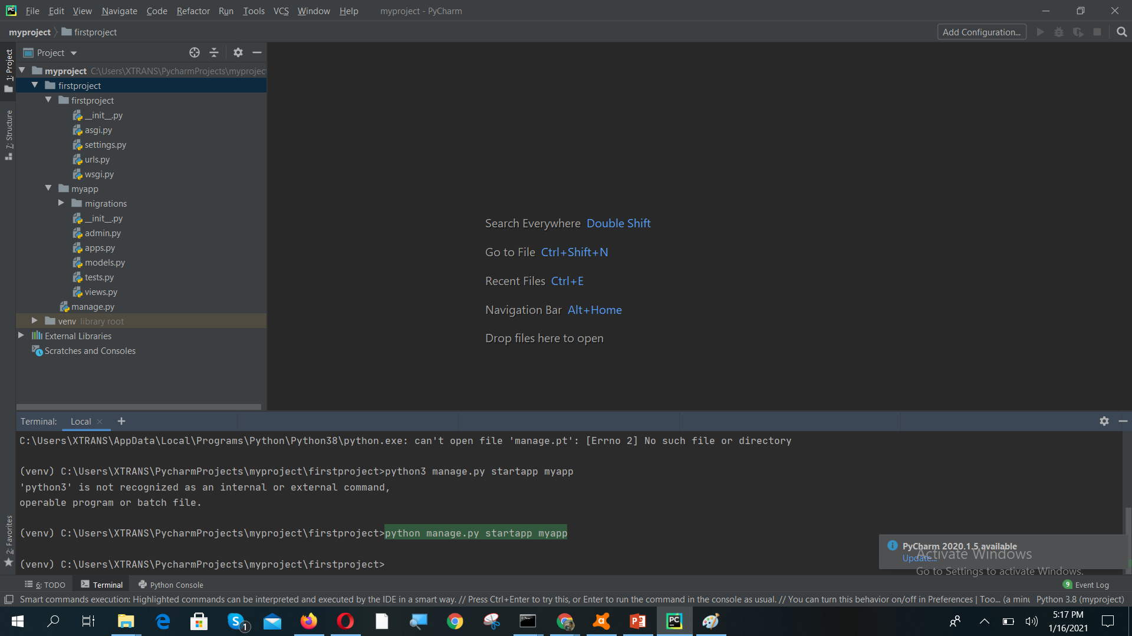
Creating Application

Slide 22
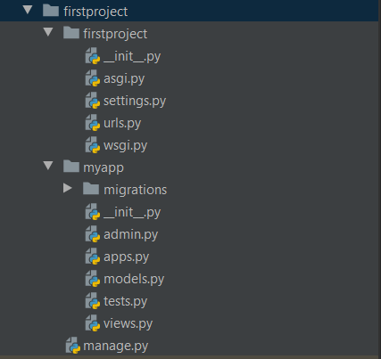
Application Folder Structure
The tool creates a new folder and populates it with files for the different parts of the application (shown in bold in the following example). Most of the files are named after their purpose (e.g. views should be stored in views.py, models in models.py, tests in tests.py, administration site configuration in admin.py, application registration in apps.py) and contain some minimal boilerplate code for working with the associated objects.

Slide 23
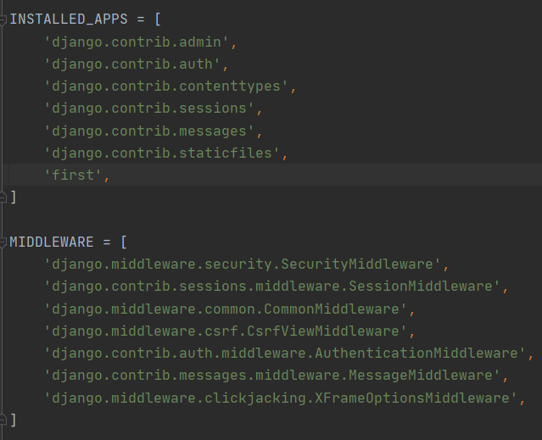
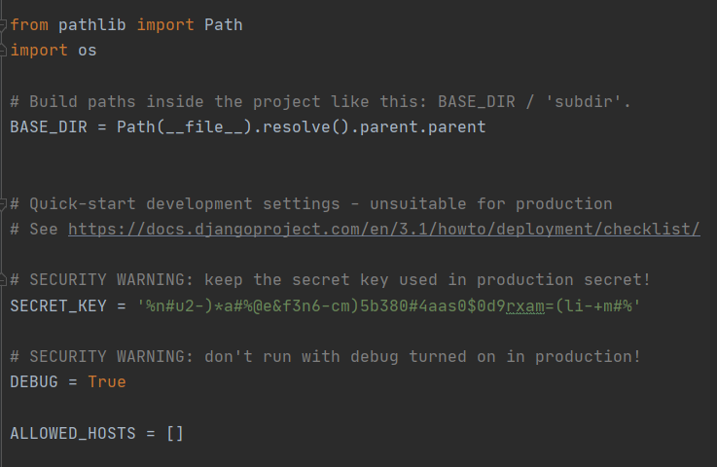
Open Settings.py

Slide 24
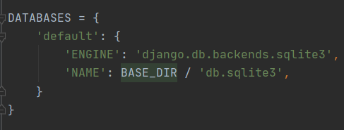
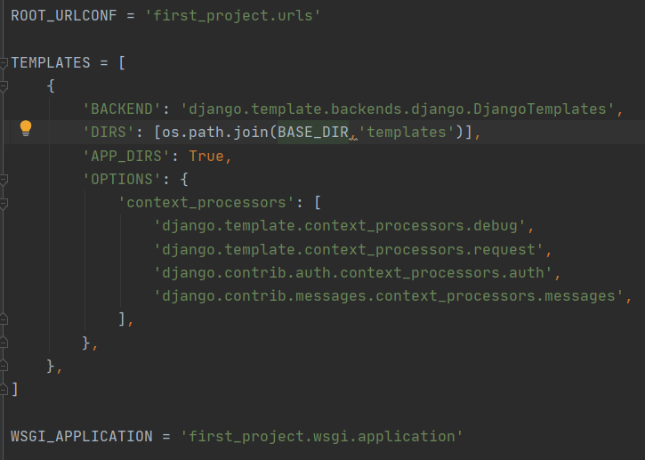
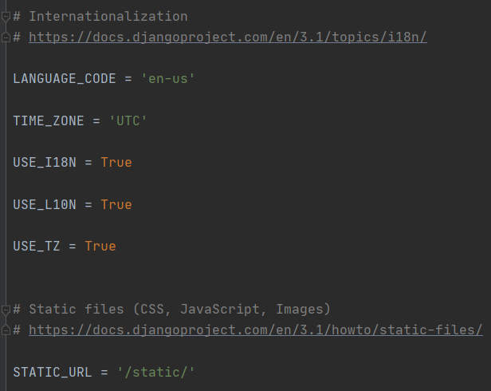
Settings.py

Slide 25
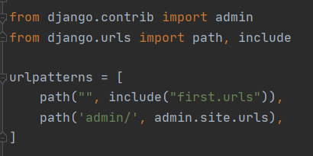
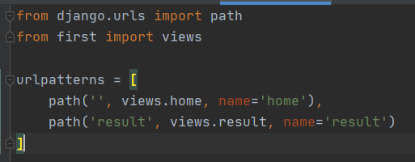
URL Setting
Application URL Settings
Project URL Settings
Empty String
App name .urls

Slide 26
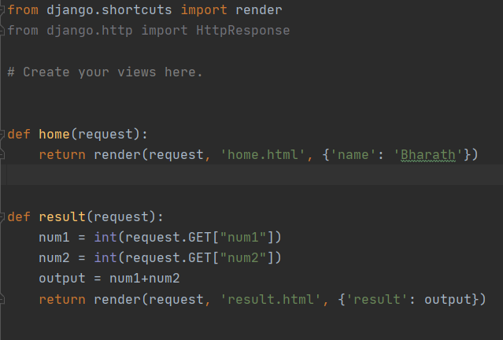
Views.py
Views.home
Views.result

Slide 27
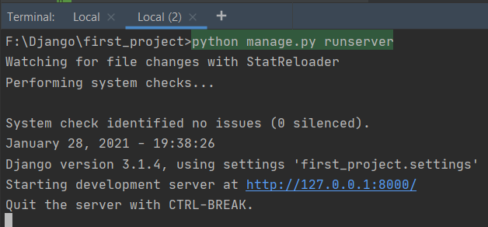
Run the Server

Slide 28
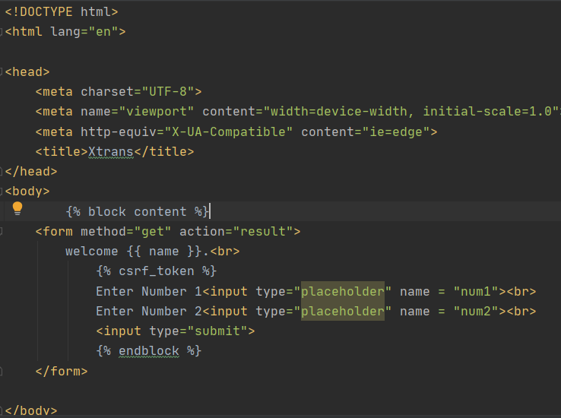
Home.html

Slide 29
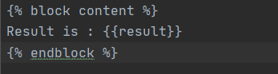
Result.html

Slide 30
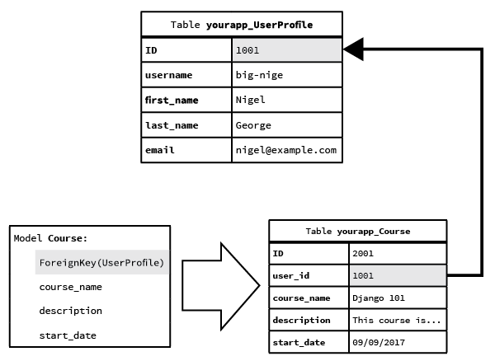
What is Model ?
Fields are specified by class attributes which represents columns in the database table(Model).
Each field in model class should be an instance of appropriate Field class (which is an abstact class).
These are the things to know for creating Model Fields.
Field Types Field Options Relationships
Each model is a Python class that inherit Django
model class “django.db.models.Model”
Each attribute of the model represents a database
field.
e.g.:
from django.db import models
Class user_profiles (models.Model):
user_name = models.CharField(max_length=30)
first_name = models.CharField( max_length=30)
last_name = models.CharField( max_length=30)
Email = models.EmailFiled(max_length = 80)
Model is the data access layer of Django.
It gives a way to access it, validate it and describes the relationships between the data.
It maps a single database table to a python class.
It handles the inconsistency of SQL across different database platforms.

Slide 31
Fields Types
IntegerField() - It stores values from -2147483648 to 2147483647.
FloatField() - It stores floating point number represented in Python by a float instance.
EmailField() - A CharField that check valid email address.
Relationship Fields
ForeignKey() - A many to one relationship requires one positional agrument to define related model
ManyToManyField() - Defines a many to many relationship with another model.
OneToOneField() - Defines a one-to-one relationship.
Django uses Field Class Type to determine the table column type.
Django uses Field Types for data validation in automatically generated forms.
e.g.:-
AutoField() - An interger field that automatically increments
BooleanField() - Store true/false value and generally used for checkboxes
CharField() - A string field for small to large-sized strings. DateField() - A date field represents python datetime.date instance

Slide 32
Field Options
Field options are used to customize and put constraint on table rows.
Each Field takes certain field specific arguments. e.g.:- name = models.CharField(max_length=60)
Here “max_length” specifies the size of the VARCHAR field.
The following are some common and mostly used field options:
null – To store empty values as NULL in database
blank - If True, the field is allowed to be blank. Default is False
default – stores default value for a field
primary_key – This field will be the primary key for the table
unique_key – Puts unique key constraint for a column

Slide 33
Models are created in app/models.py (Ex : djdemo/models.py)
Setting admin to register our model in djdemo/admin.py
from django.db import models
class UserDetails(models.Model):
user_name = models.CharField( max_length = 100)
first_name = models.CharField( max_length = 100)
last_name = models.CharField( max_length = 100)
email = models.EmailField( max_length = 100)
Setting admin to register our model in djdemo/admin.py
from django.contrib import admin
from djdemo import models
admin.site.register( models.UserDetails)

Slide 34
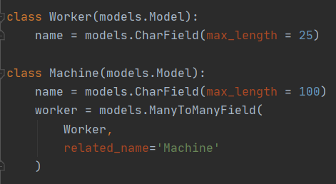
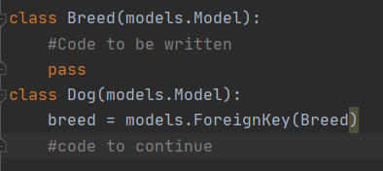
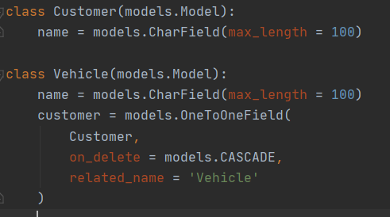
Model Field Relationships
ManyToMany:
Django provides ways to define the three most common types of database relationships:
many-to-one
many-to-many
one-to-one
ManyToOne:
To define a many-to-one relationship we use “django.db.models.ForeignKey”
It requires a positional argument: related model name
OneToOne:

Slide 35
Meta Options
Give your model metadata by using an inner class Meta: e.g:
class Student(models.Model):
name = models.CharField(max_length=50)
class Meta:
ordering = ["name"] db_table = “students”
Few meta options:
ordering
db_name
unique_together
index_together
abstract
proxy

Slide 36
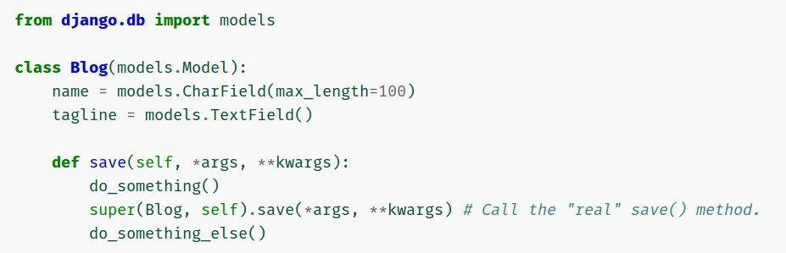
Model Methods
We can create custom methods on a model to add custom “row- level” functionality to the model objects. Whereas Manager methods are intended to do “table-wide” things.
It is a good technique to keep all your business logic in one place inside the model class
e.g.:
class Student(models.Model):
first_name = models.CharField(max_length=50) last_name = models.CharField(max_length=50)
def get_full_name(self):
"Returns the person's full name."
return '%s %s' % (self.first_name, self.last_name)
There are some predefined model methods that encapsulate database behavior that you can override to customize it.
Few predefined model methods are save(), delete(), pre_save(), pre_delete() etc.

Slide 37
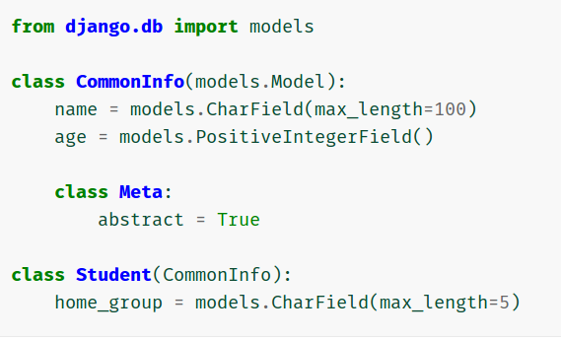
Model Inheritance
Model inheritance in Django works almost identically to the way normal class inheritance works in Python.
There are three types of inheritance in Django model:
Abstract base classes
Multi table inheritance
Proxy Models
Abstract base classes
It is useful to keep all the common information into one model to follow DRY principles.
This model will not be used to create database table.
Add “abstract = True” in the meta class to make any model abstract.

Slide 38
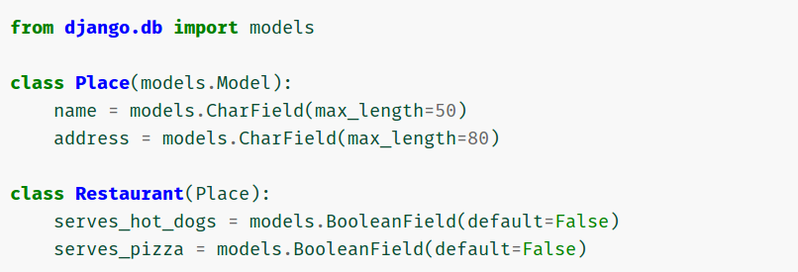
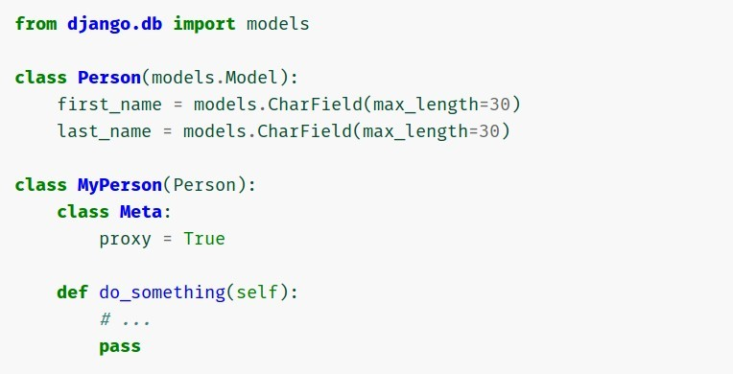
Multi table inheritance
Proxy models
The inheritance relationship create links between the child model and each of its parents (via an automatically-created OneToOneField)
Here each model corresponds to its own database table
This models are used to change the default manager and add new methods to change python behavior of a model without altering the original model.
Add “proxy = True” in the meta class to make any model abstract.

Slide 39
Commands
$ $python manage.py createsuperuser
To create a superuser
$ python manage.py makemigrations
To create new migration based on the changes you made in your models
$ python manage.py migrate
To apply migration into your database

Slide 40
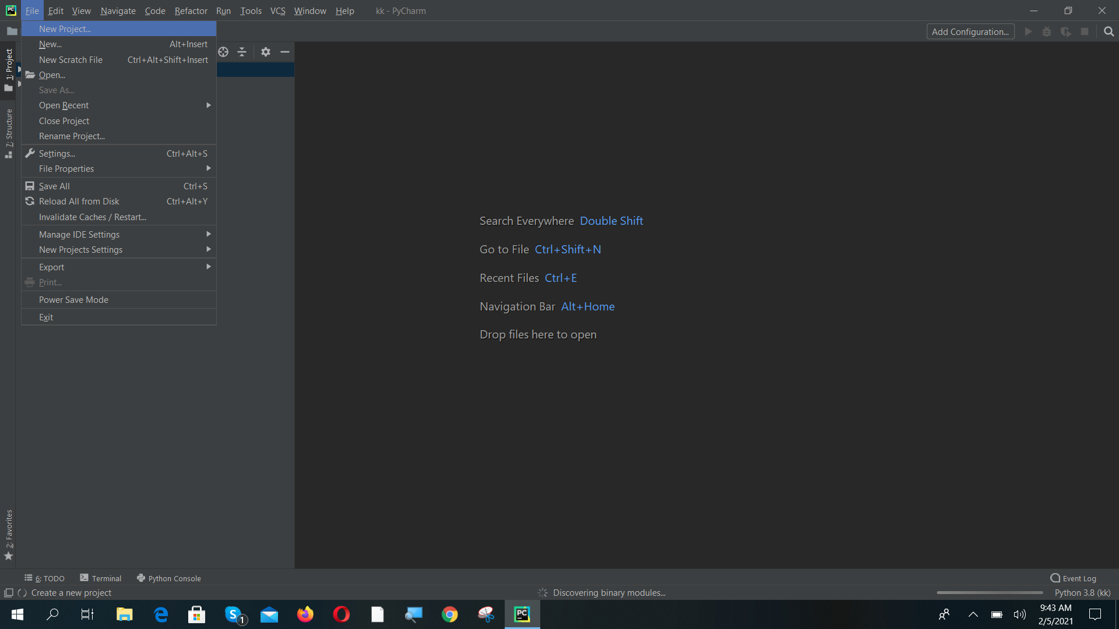
Open a Pycharm Project.

Slide 41
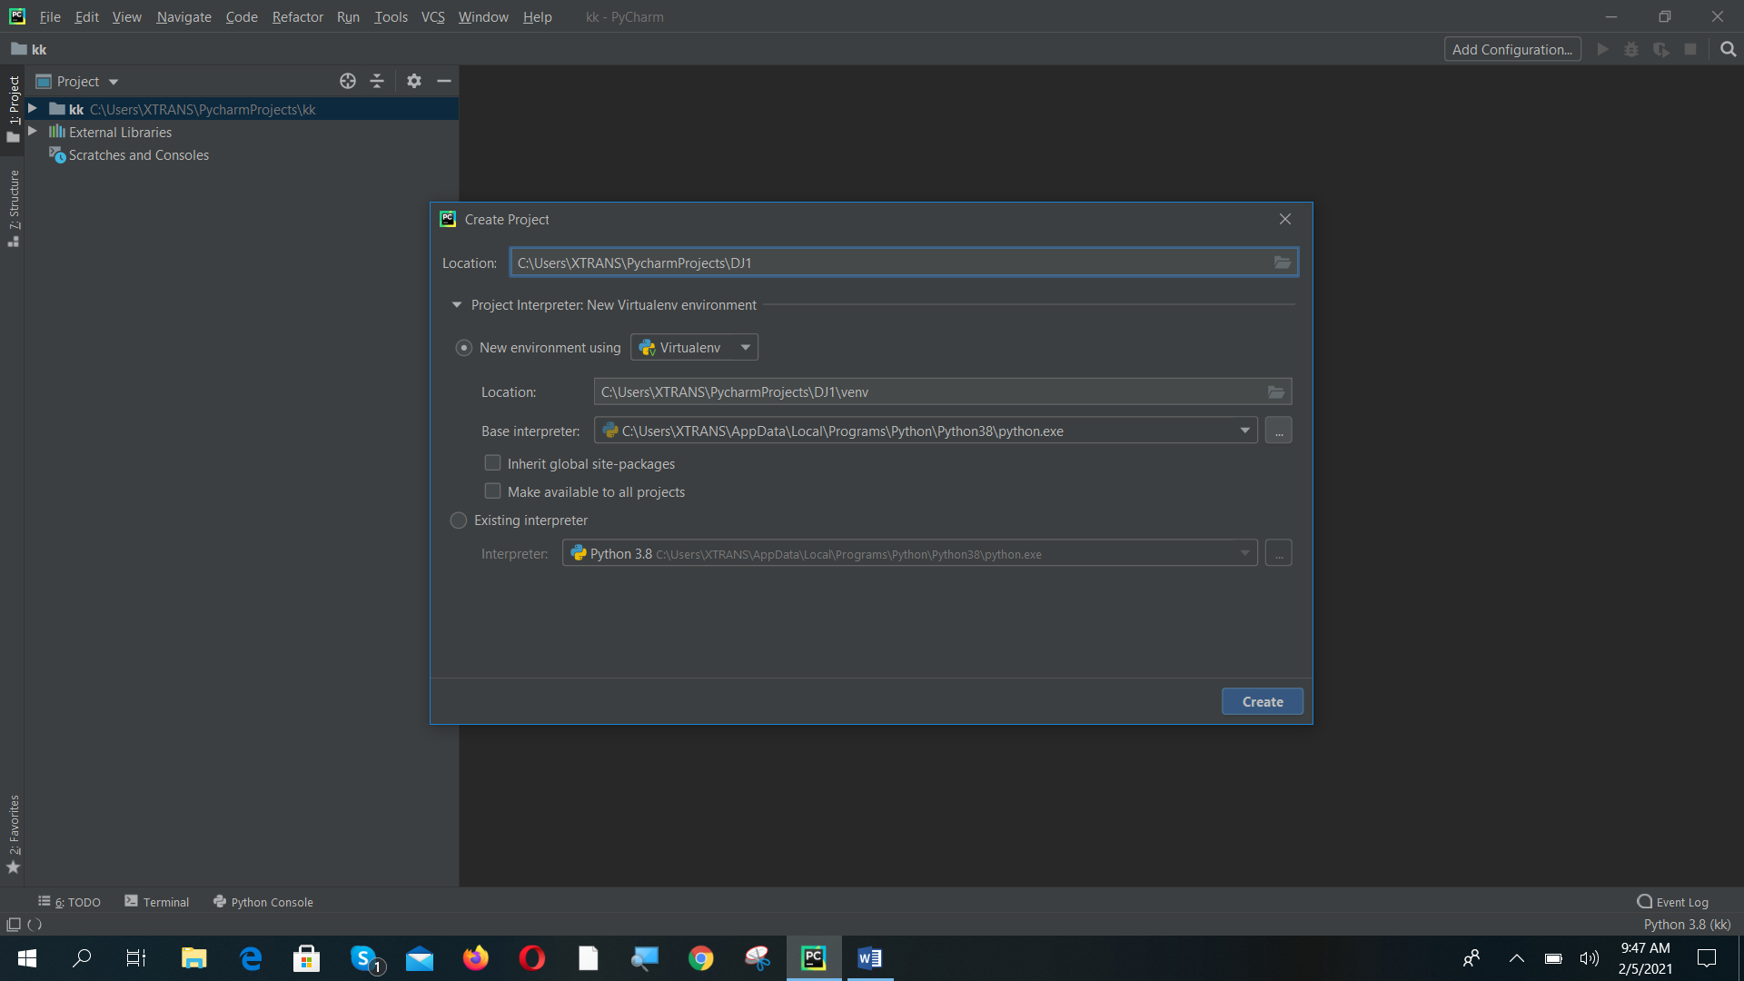
Give a Name to pycharm project and select new environment with Virtualenv. Make sure that base interpreter is your python path. Click on Create.

Slide 42
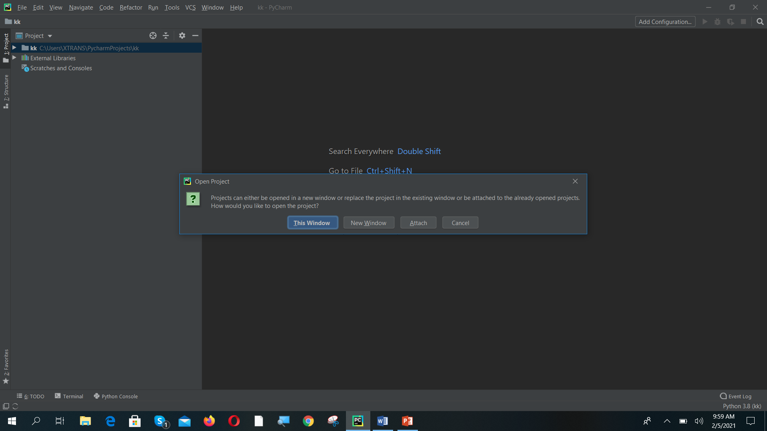
Click on new window

Slide 43
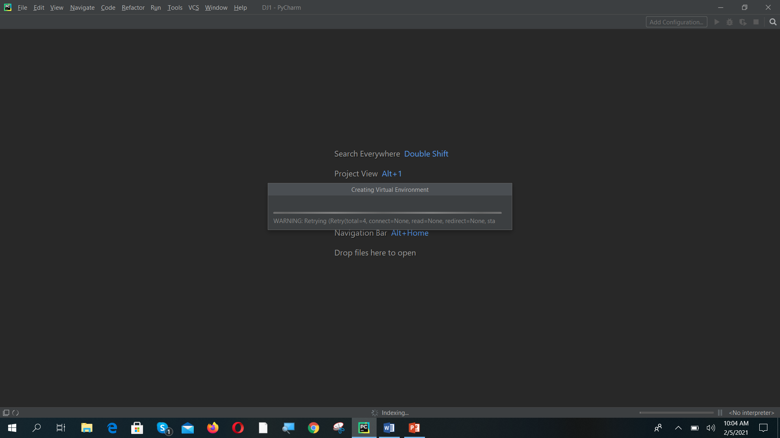
Loading new virtual environment

Slide 44
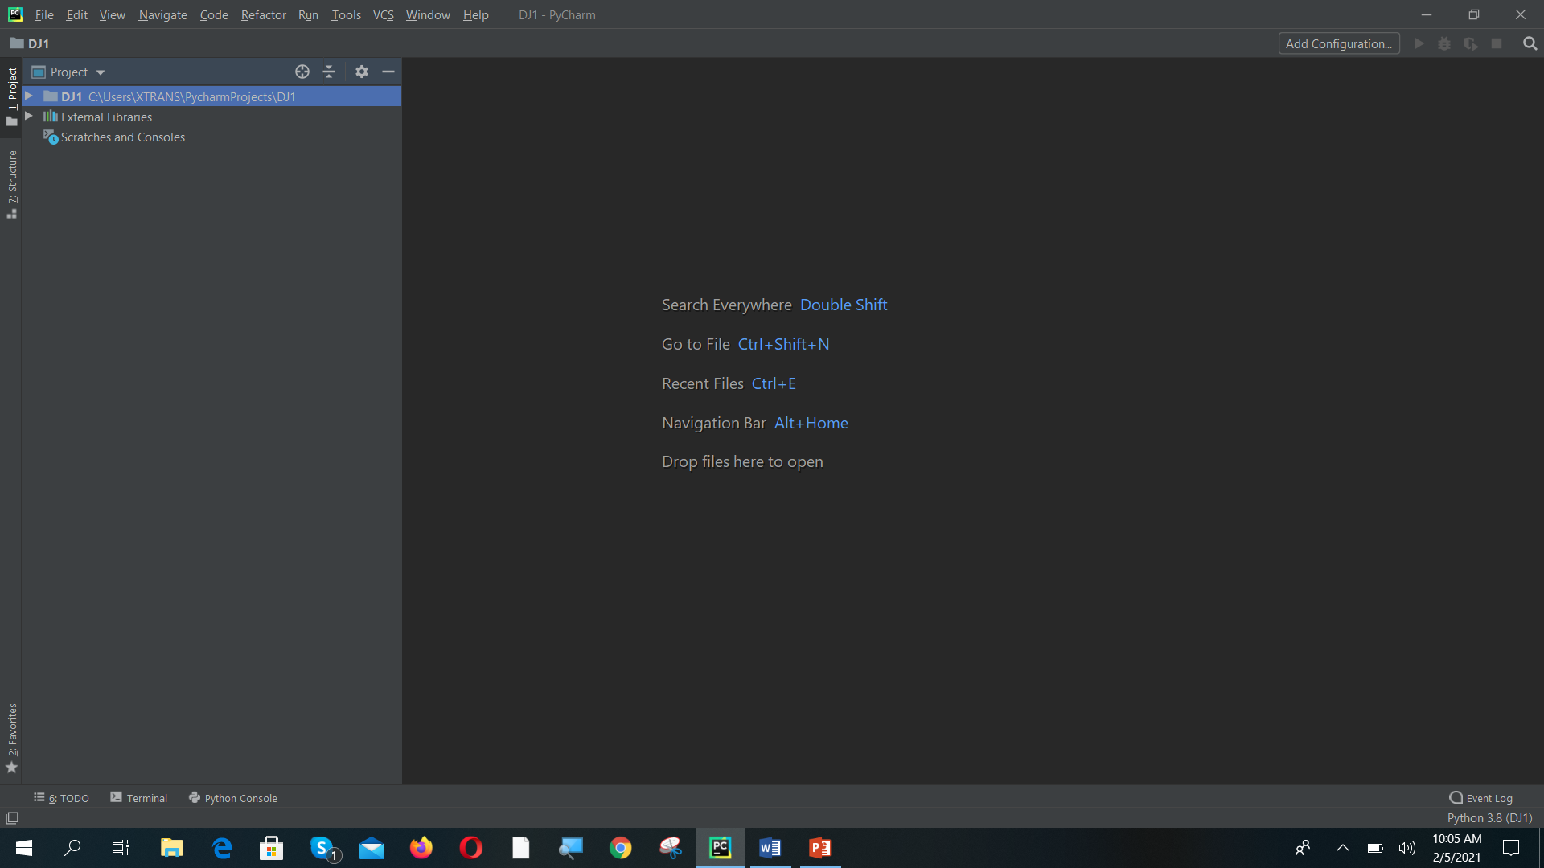
Pycharm project opened. Click on the terminal to create Django project

Slide 45
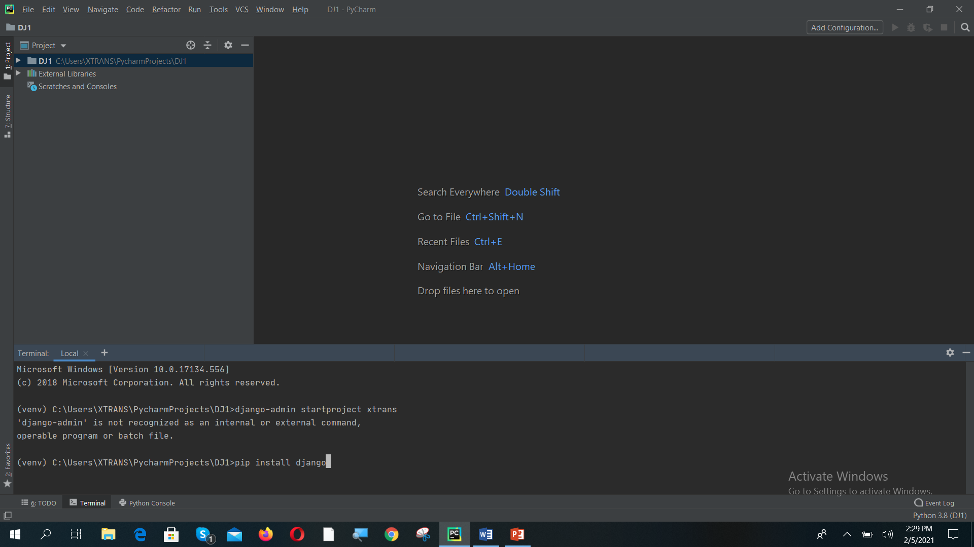
Install Django library using command “pip install Django”

Slide 46
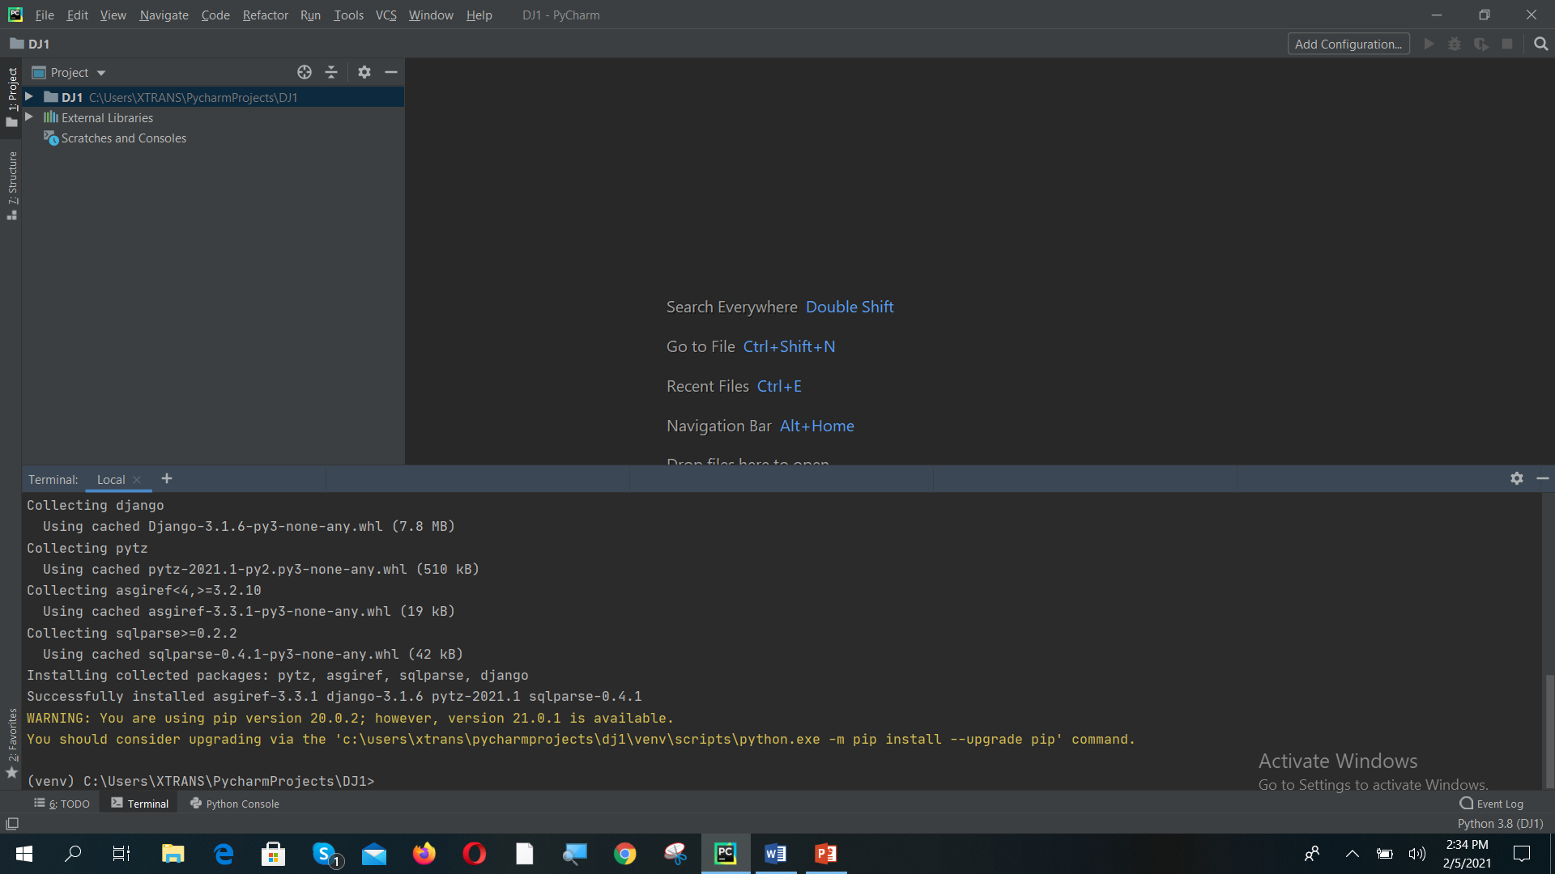
Django installed

Slide 47
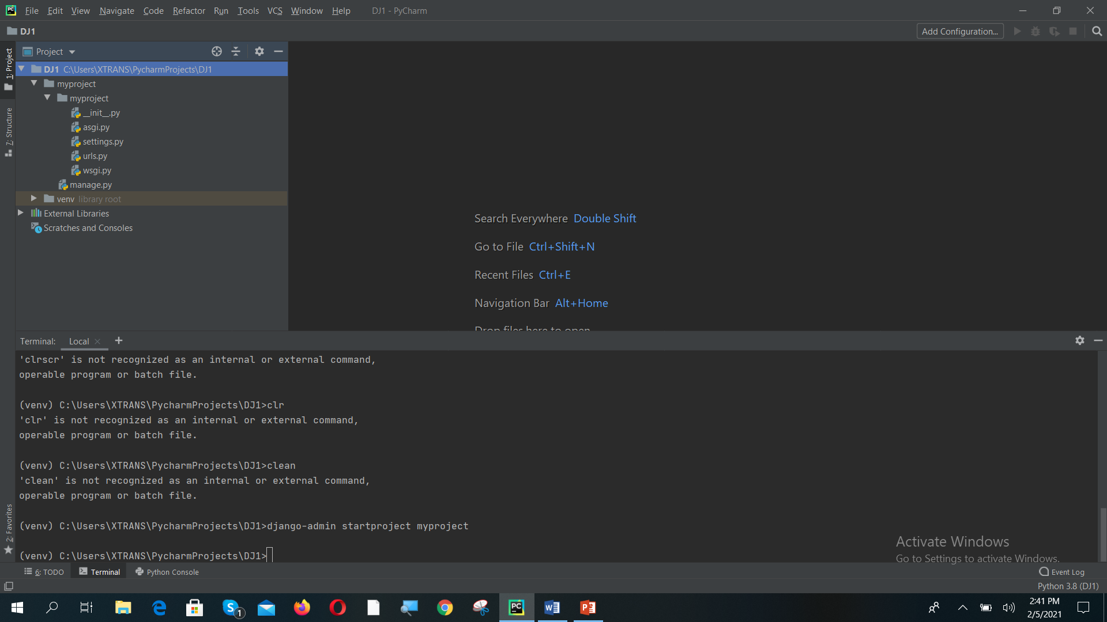
Create a Django project using “Django-admin startproject myproject”. And expand DJ1→myproject→myproject. You can observe the required files.

Slide 48
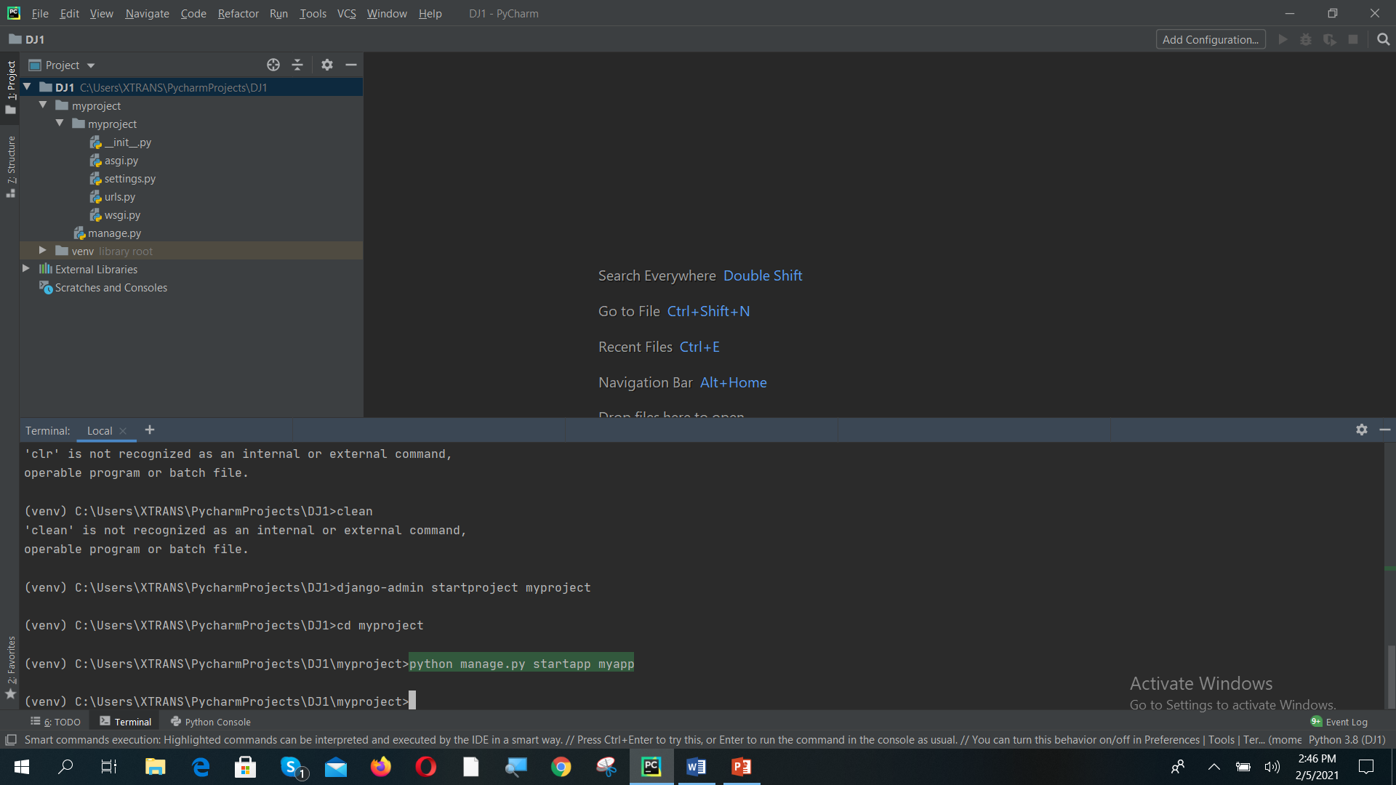
Change the directory using “cd myproject” and Create a app in the Django project using “python manage.py startapp myapp”

Slide 49
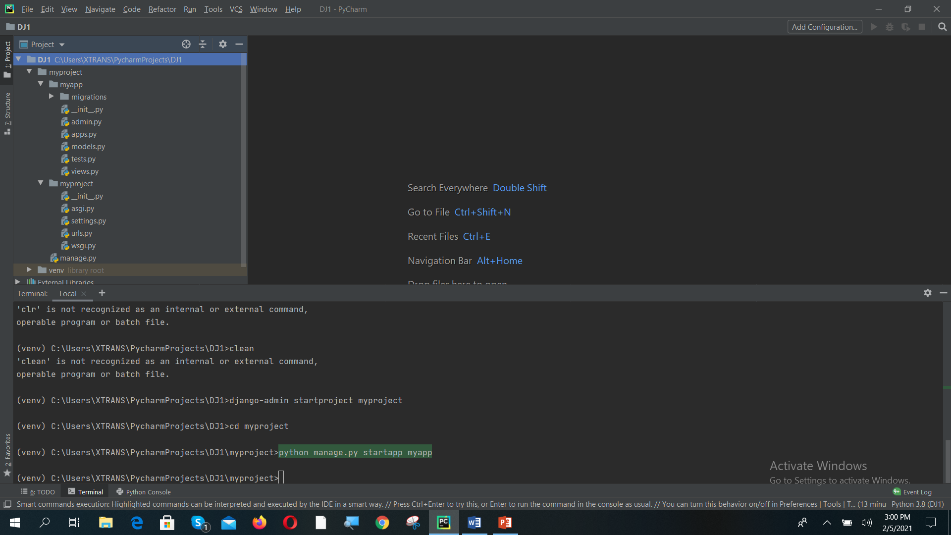
Expand the myapp folder and observe the files inside the folder

Slide 50
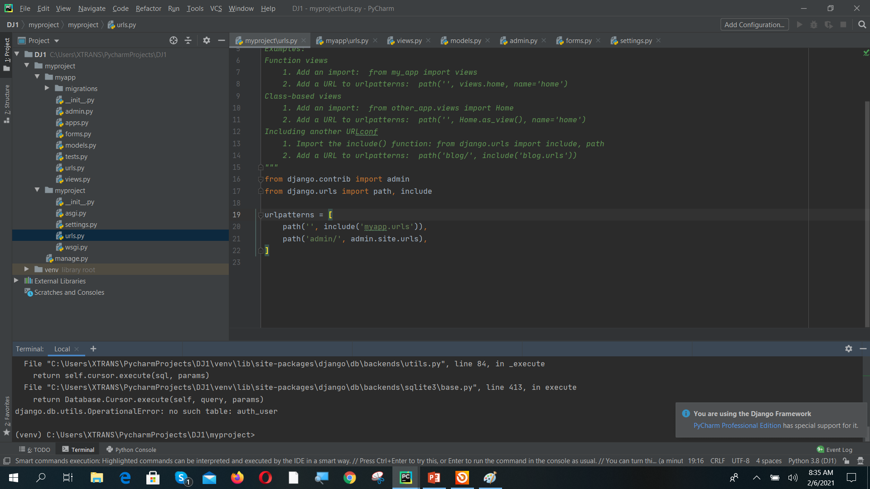
Add one line in myproject/urls.py

Slide 51
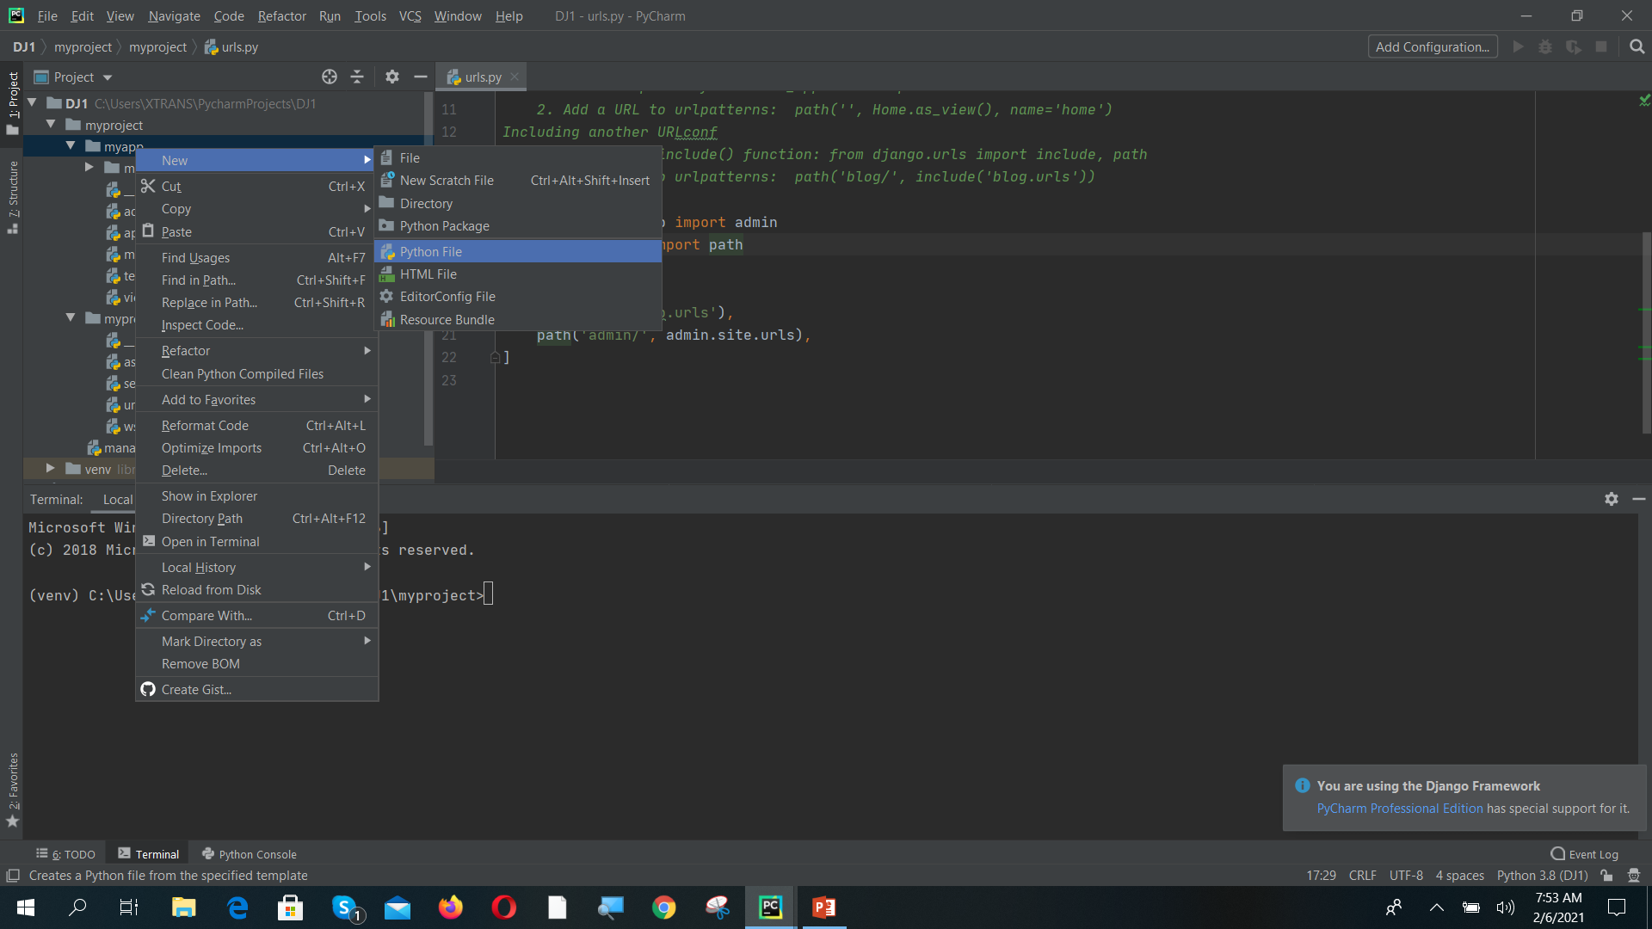
Create urls.py file in myapp folder

Slide 52
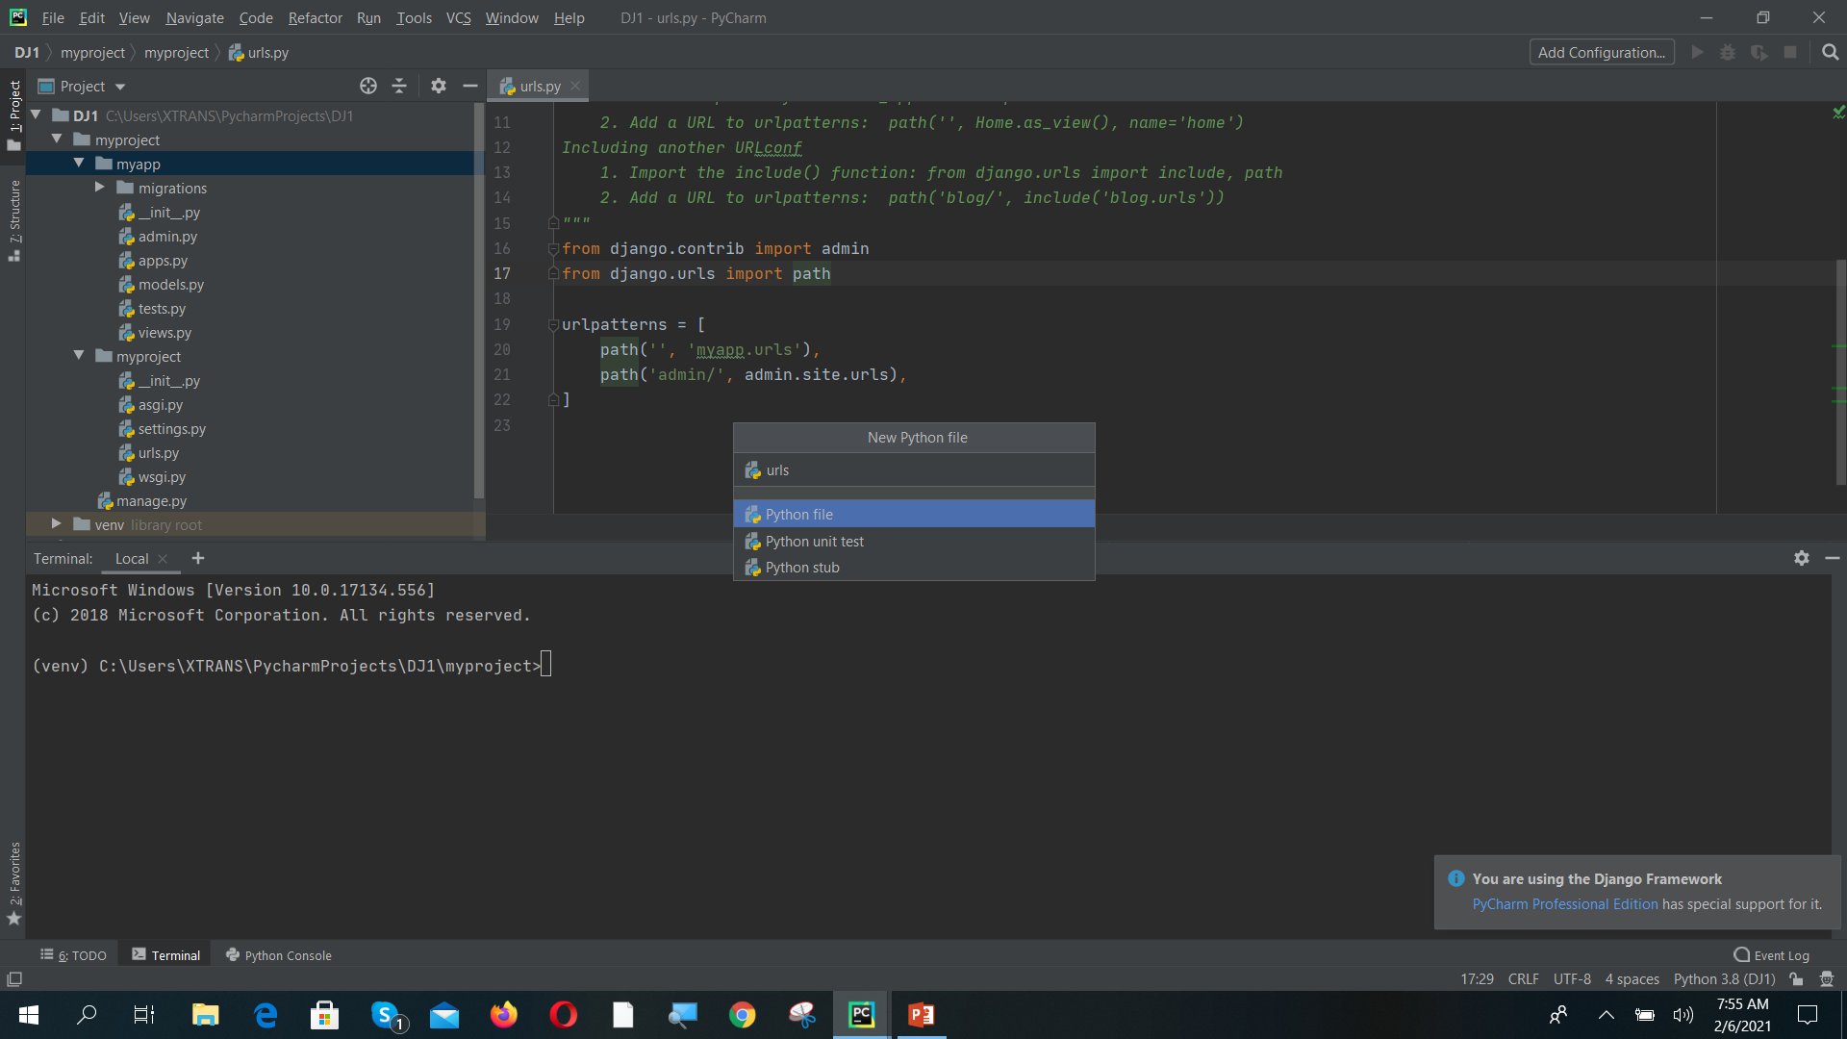
Name the file as “urls”

Slide 53
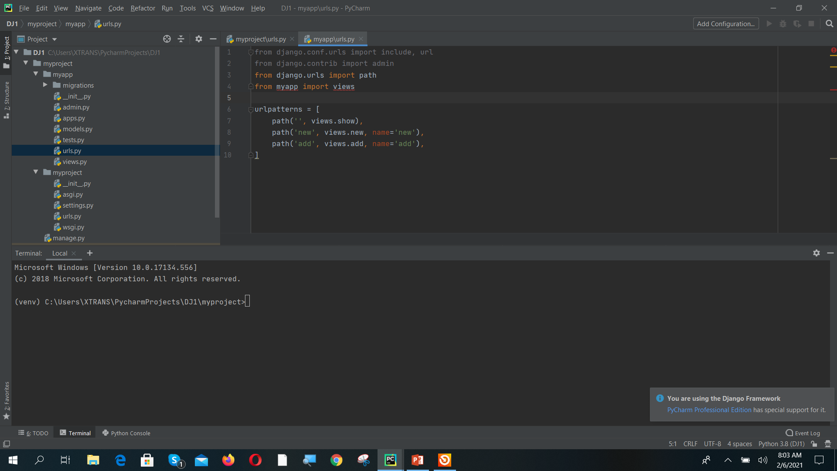
Copy and paste contacts/urls.py to myapp/urls.py

Slide 54
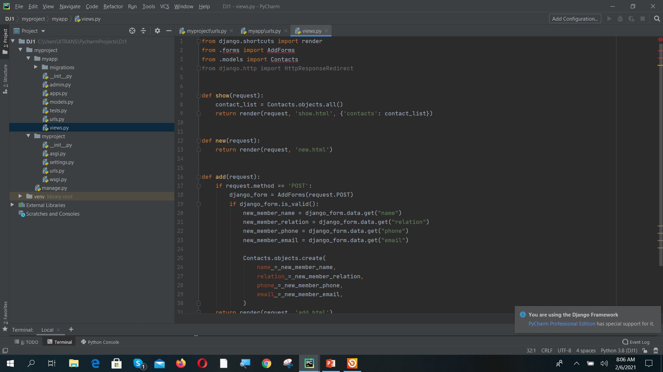
Open myapp/views.py and copy paste contacts/views.py to myapp/views.py

Slide 55
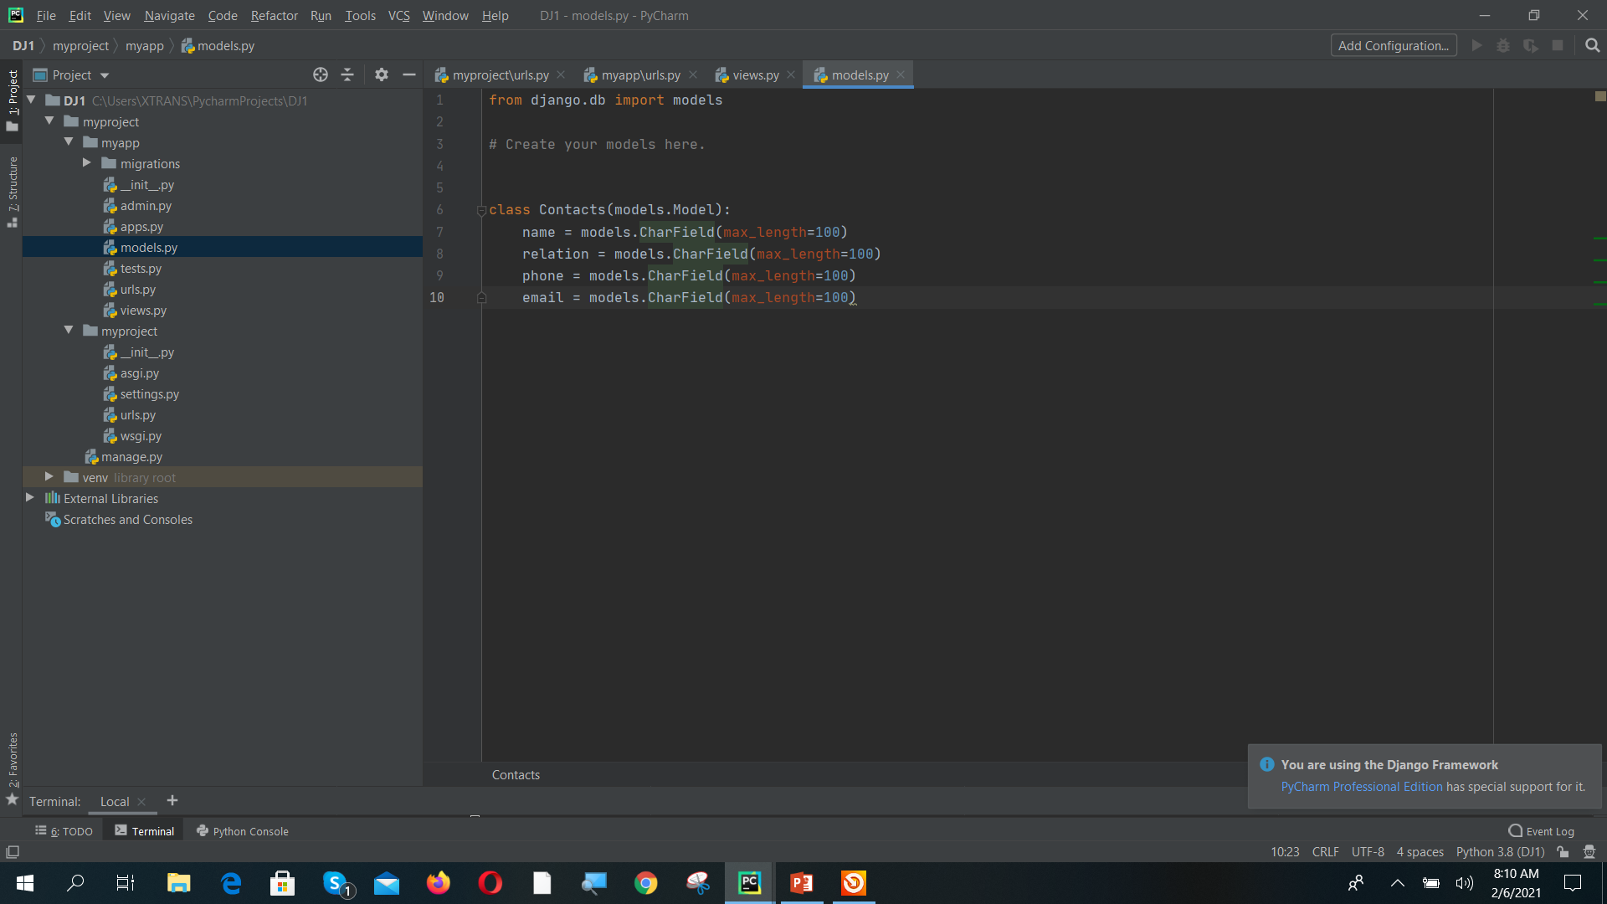
Open myapp/models.py and copy paste contacts/models.py to myapp/models.py

Slide 56
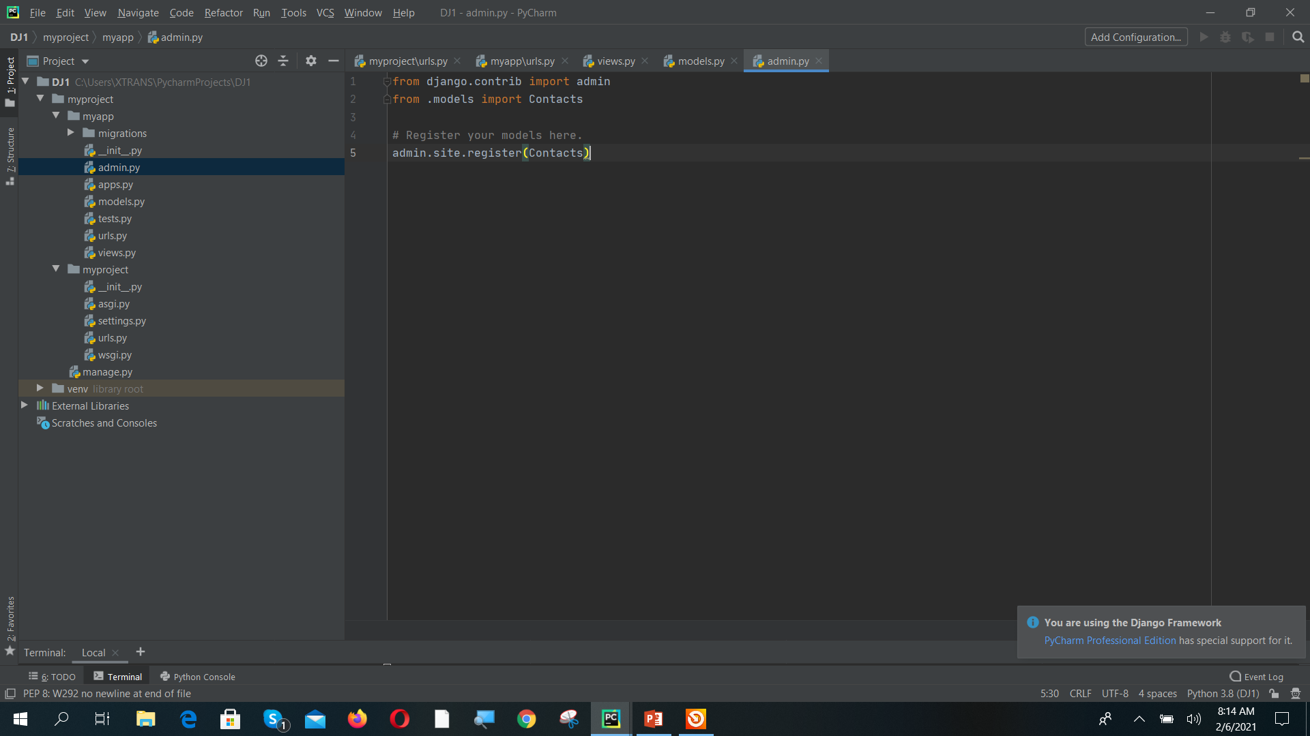
Open myapp/admin.py and copy paste contacts/admin.py to myapp/admin.py

Slide 57
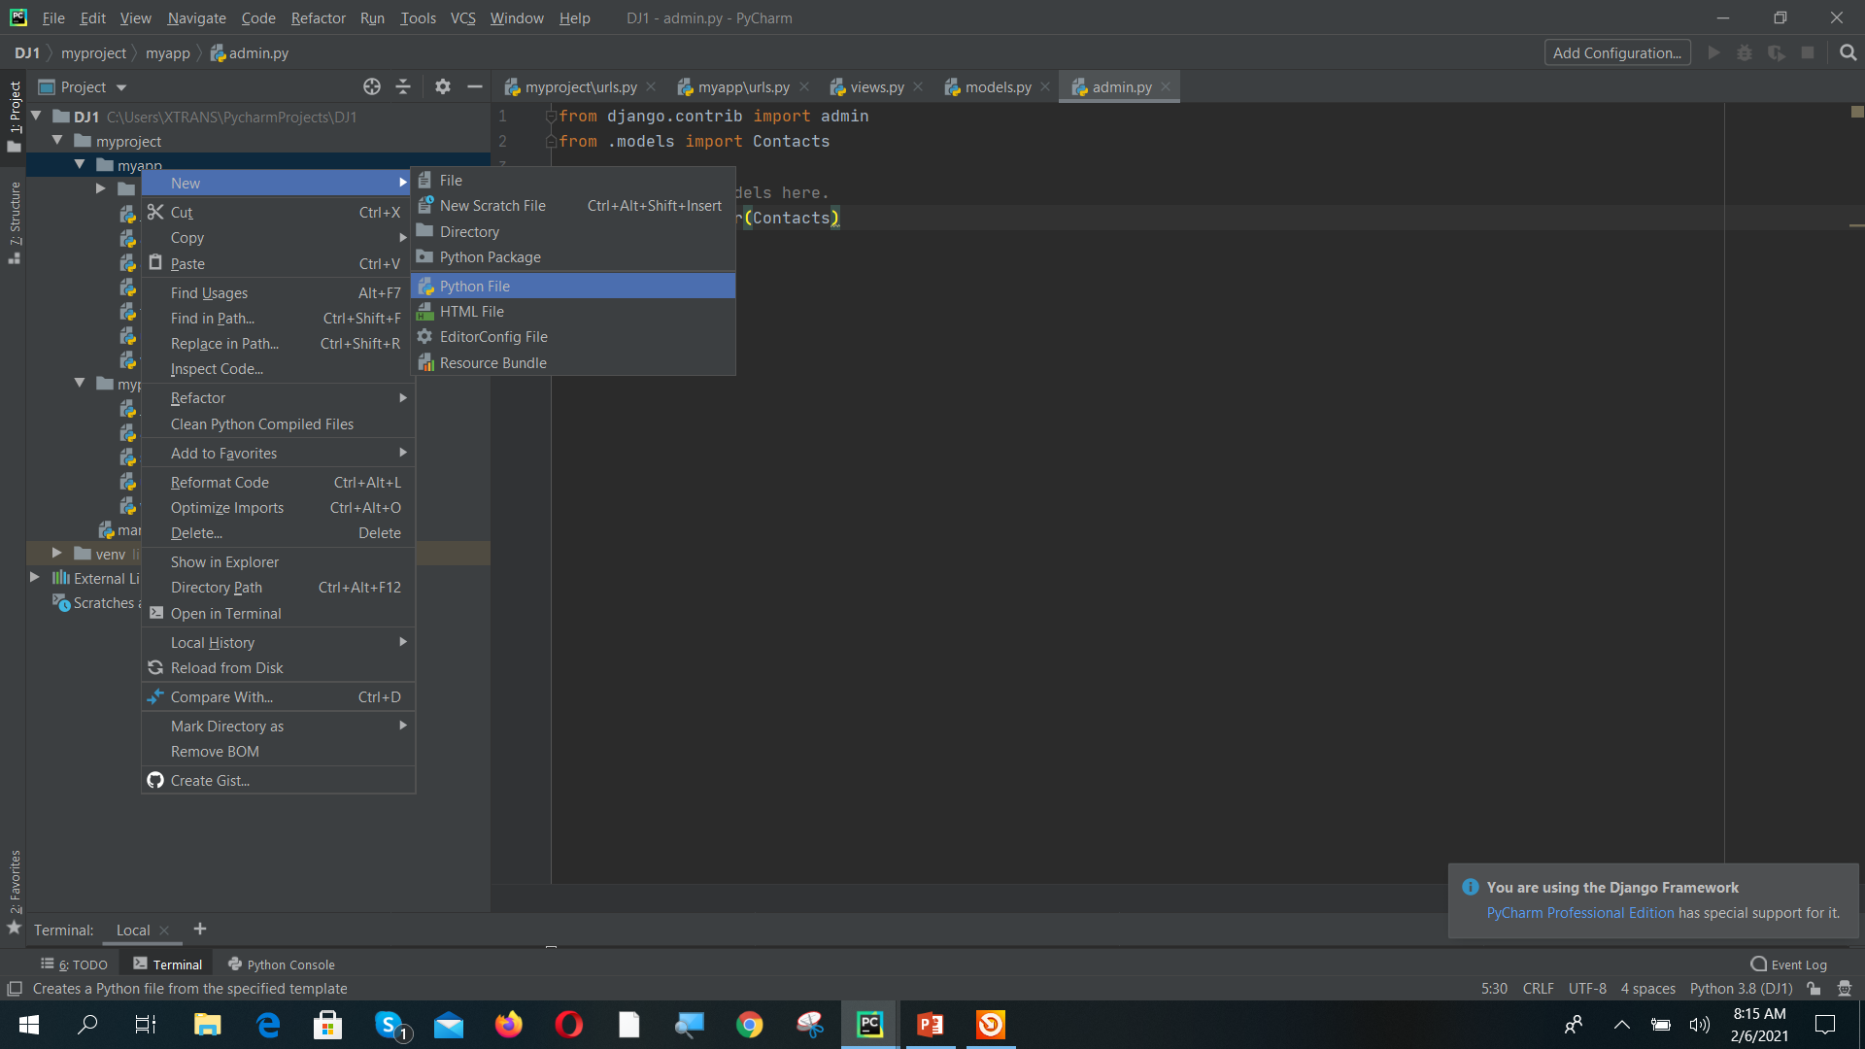
Right click on myapp folder and Create a new python file.

Slide 58
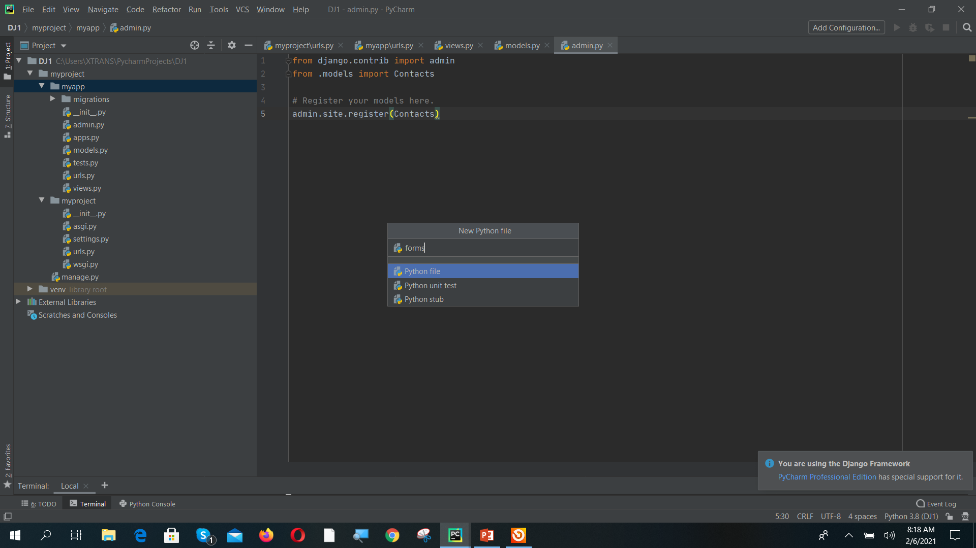
Name the file as “forms”

Slide 59

Now copy paste contacts/forms.py to myapp/forms.py

Slide 60

Right click on myproject folder and Create new directory

Slide 61

Name the directory as templates

Slide 62

Observe the folder template created now copy 3 html files named “show.html”, “new.html”, “add.html” from first_project/template folder

Slide 63

Observe the copied html files in templates folder

Slide 64


Now open myproject/settings.py and do the following three changes and save the file.

Slide 65

Update the models using terminal command “python manage.py makemigrations”

Slide 66

Store the model in database using terminal command “python manage.py migrate”

Slide 67

Create superuser for Managing database fields.

Slide 68

Now run the server using terminal command “python manage.py runserver”

Slide 69

Open Django admin page in any browser using “http://localhost:8000/admin” and add data to database. Enter username and password of your superuser created earlier and login

Slide 70

Click on contacts +Add symbol to add data to table.

Slide 71

Fill the details and click on save

Slide 72

Contact Added Successfully

Slide 73

Now run the server without admin “localhost:8000”. You are able to see existing contacts. Click on Add New to create new contact from webpage.

Slide 74

Fill the details and click on submit

Slide 75

Data added to database through webpage

Slide 76

Rerun “localhost:8000”

Slide 77
Django Templates
Django template is a text document or Python string marked up that uses Django template language.
Django keeps the logic and code separate from the design. It is essential to know that Django templates do not contain the embedded code of Python into HTML.
Django templates follow the DRY (do not repeat yourself) design principle, which requires developers to not repeat while designing a Django application.
Django templates employ several other notions, such as template inheritance, tags, variables, filters, comments, etc.

Slide 78

Template Configuration
To configure the Django template system, go to the settings.py file and update the DIRS to the path of the templates folder. Generally, the templates folder is created and kept in the sample directory where manage.py lives.
This templates folder contains all the templates you will create in different Django Apps.
Alternatively, you can maintain a template folder for each app separately.
If you are maintaining the template for every app separately, you don't need to update the DIRS in settings.py.
Make sure that your app is added in INSTALLED_APPS in settings.py

Slide 79

Django Template Language
In the Django template language, the syntax involves four major constructs.
Variables
Tags
Filters
Comments
1. Variables
Variables output the value from the context. The context is generally a dict-like object (mapping variable name with its respective value) passed from views.
The basic syntax is:

Slide 80

Example
In views.py you can define the context and pass the context to index.html as parameter

Slide 81


You can access the context variables in HTML file and run the server.

Slide 82
Tags
In a template, Tags provide arbitrary logic in the rendering process. For example, a tag can output content, serve as a control structure e.g. an "if" statement or a "for" loop, grab content from a database etc.
Tags are surrounded by {% %} braces.
For example.
Display Logic. E.g., {% if %}...{% endif %}
Loop Control. E.g., {% for x in y %}...{% endfor %}
Block Declaration. E.g., {% block content %}...{% endblock %}
Content Import. E.g., {% include "header.html" %}
Inheritance. E.g., {% extends "base.html" %}

Slide 83


Django Static Files Handling
In a web application, apart from business logic and data handling, we also need to handle and manage static resources like CSS, JavaScript, images etc.
The django.contrib.staticfiles module helps to manage them.
Django Static (CSS, JavaScript, images) Configuration
Include the django.contrib.staticfiles
in INSTALLED_APPS.
2. Define STATIC_URL in settings.py file as given below.

Slide 84



3. Load static files in the templates by using the below expression.
4. Store all images, JavaScript, CSS files in a static folder of the application. First create a directory static, store the files inside it.

Slide 85

After Creating Static Folder the project structure is looks like this

Slide 86

Image Loading Example
Copy any image file to static folder and In index.html add image file shown below.

Slide 87

Loading JS file
To load JavaScript file, just add the following line of code in index.html file.

Slide 88






Create a js folder in static folder and write an script.js file
Script.js file

Slide 89

Output after adding js script file

Slide 90

Loading CSS Example

Slide 91


Add following code to html file to load css files
<link href="{% static 'css/style.css' %}" rel="stylesheet">
Output After Applying CSS.

Slide 92


Steps to create a form using {{ form.as_p }} tag
Step 1 : Create a model in model.py file using model fields.
Step 2 : Create a forms.py file to access the model and convert it to Form.

Slide 93

Steps to create a form using {{ form.as_p }} tag
Step 3 : Write a view function to load the ModelForm from forms.py.

Slide 94



Steps to create a form using {{ form.as_p }} tag
Step 4 : Add HTML Url path in ex1/urls.py and create html file and add form tag in HTML
In any template that uses a POST form, use the csrf_token tag inside the <form> element if the form is for an internal URL, e.g.:
<form method="post">{% csrf_token %}

Slide 95


Steps to create a form using {{ form.as_p }} tag
Step 4 : Add Following Code in views.py and copy add.html to templates folder

Slide 96

If and For loop Tags

Slide 97

Filters Usage in Templates
Filters the contents of the block through one or more filters. Multiple filters can be specified with pipes and filters can have arguments, just as in variable syntax.
Syntax
{{ variable_name | filter_name }}

Slide 98
Major Filters Used
add | addslashes | capfirst
center | cut | date
default | dictsort | divisibleby
escape | filesizeformat | first
join | last | length
linenumbers | lower | make_list
random | slice | slugify
time | timesince | title
unordered_list | upper | wordcount

Slide 99
Sample Filters and Syntaxes
add
It is used to add an argument to the value.
Example
{{ value | add:"2" }}
If value is 4, then the output will be 6. This filter is used to increment a variable in django Templates.
addslashes
It is used to add slashes before quotes. Useful for escaping strings in CSV.
Example
{{ value | addslashes }}
center
It is used to center the value in a field of a given width.
Example
"{{ value | center:"15" }}"
If value is “Jai”, the output will be ” Jai “.
cut
It is used to remove all values of argument from the
given string.
Example
{{ value | cut:" " }}
If value is “String with spaces”, the output will be “Stringwithspaces”.
If value is “I’m Jai”, the output will be “I\’m Jai”.
date
It is used to format a date according to the given format.
Example
{{ value | date:"D d M Y" }}
If value is a datetime object (e.g., the result of datetime.datetime.now()), the output will be the
string ‘Thu 06 Feb 2020’.
capfirst
It is used to capitalize the first character of the value. If the first character is not a letter, this filter has no effect.
Example
{{ value | capfirst }}
If value is “jai”, the output will be “Jai”.

Slide 100
Django ORM

Slide 101


Django ORM
Python
SQL
from django.db import models
class Blog(models.Model):
name = models.CharField(max_length=100)
tagline = models.TextField()
def __str__(self):
return self.name
Create Table Blog(id Integer Notnull Autoincrement,
Name Varchar(100)
Tagline varchar(1000)
)

Slide 102

What is ORM?
Object - Relational Mapping
Django's ORM is just a pythonical way to create SQL to query and manipulate your database and get results in a pythonic fashion
ORM is a technique for converting data between incompatible type systems in object oriented programming Languages. This creates, in effect, a ‘virtual object database’ that can be used from within the programming Language.
ORM is a bunch of code
i) Provides a set of APIs which allows access databases in OO style ii) helps database becomes more transparent
In ORM
i) Each class represents a table and is called as model
ii) Each Property represents as column
iii) Each Object has methods to interact with the database
1. Save for Insert and Update
2. Delete for Delete data
3. And other methods to load records.

Slide 103


How to create a Model?
Step 1 : Add a class.
Add a class which represents a table.
Must inherit from Model Class.
Model class inside the model package (django.db.models.Model)
Step 2 : Add Properties which represents columns (fields).
Property_name = Model.type(Field_Options)
Type is some field class inside the model(you can create and use customize field classes)
Each property name is an instance of some field classes.
Each field class represents a column type, which tells to database to store which kind of data.
Field_Options are a set field specific properties.

Slide 104

Field Types and Options
Integer Fields
property_name = models.BigIntegerField(fieldOptions)
property_name = models.IntegerField(fieldOptions)
property_name = models.SmallIntegerField(fieldOptions)
property_name = models.PositiveIntegerField(fieldOptions)
property_name = models.PositiveSmallIntegerField(fieldOptions)
property_name = models.FloatField(fieldOptions)
fieldOptions:
null: bool value to indicate if null value is allowed. False by default.
default: default value if none is provided
String Fields
P r o p e r t y_n a m e = m o d e l s. C h a r F I e l d ( f I e l d O p t I o n s)
P r o p e r t y _ n a m e = m o d e l s . T e x t F I e l d( f I e l d O p t I o n s)
fieldOptions:
max_length: Integer number represent maximum number of characters.
null: bool value to indicate if null value is allowed. False by default.
blank: bool value to indicate if empty string is allowed. False by default.
default: default value if none is provided
choices: enumeration
Boolean Fields
property_name = models.BooleanField(fieldOptions)
property_name = models.NullBooleanField(fieldOptions
fieldOptions:
null: bool value to indicate if null value is allowed. False by default.
default: default value if none is provided

Slide 105
Field Types and Options
All that will be stored in your database is a path to the file (relative to MEDIA_ROOT). You can get absolute path use mug_shot.url
Date Time Fields
property_name = models.DateField(fieldOptions)
property_name = models.TimeField(fieldOptions)
property_name = models.DateTimeField(fieldOptions)
models.ImageField
Inherits all attributes and methods from FileField, but also validates that the uploaded
object is a valid image.
height_field=None, width_field=None
fieldOptions:
auto_now: automatically set the field to now every time the object is saved. False by default. Note that the current date is always used; it’s not just a default value that you can override.
models.EmailField
A CharField that checks that the value is a valid email address. max_length=254
auto_now_add: automatically set the field to now when the object is first created. Note that the current date is always used; it’s not just a default value that you can override.
models.UrlField
A CharField that checks that the value is a valid url. max_length=200
Other Fields
models.FileField
models.GenericIPAddressField
upload_to: the string value will be appended to your MEDIA_ROOT path to form the location on the local filesystem where uploaded files will be stored. upload_to may also be a callable, such as a function
A CharField that checks that the value is a valid IP address. protocol: both, IPv4, IPv6. unpack_ipv4: to convert a packed address(::ffff:192.0.2.1) to ipv4 address (192.0.2.1)

Slide 106

Database Relationships
Django adds relationships fields to mange the relations between the data of different tables(classes)
Foreign key
ManyToManyField
OneToOneField

Slide 107



Examples of Relationship
OneToOne
ManyToOne( Forein Key)
ManyToMany

Slide 108
How to connect to database and sync to models
Database Settings
We can create custom methods on a model to add custom “row- level” functionality to the model objects. Whereas Manager methods are intended to do “table-wide” things.
It is a good technique to keep all your business logic in one place inside the model class
e.g.:
class Student(models.Model):
first_name = models.CharField(max_length=50) last_name = models.CharField(max_length=50)
def get_full_name(self):
"Returns the person's full name."
return '%s %s' % (self.first_name, self.last_name)
Syncing to Database
$ python manage.py makemigrations
To create new migration based on the changes you made in your models
$ python manage.py migrate
To apply migration into your database

Slide 109

pythonanywhere.com. Click on Pricing and Signup

Slide 110

To create an account click o Create Beginner account.

Slide 111

Fill the Username and Email details and click on Register.

Slide 112

Click on End tour

Slide 113

Dashboard Looks Like This. To Create a Virtual Environment click on Bash.

Slide 114

Create a virtual Environment using mkvirtualenv <name>

Slide 115

Install django in virtual environment. Then click on backspace to get back to dashboard

Slide 116

Before upload your django project create a zip file of your project

Slide 117

This is the zip file to be upload to pythonanywhere website

Slide 118

Go back to dashboard and click on files and then click on upload a file

Slide 119

Select your zip file and click on open

Slide 120

File Uploaded. Now go back to bash and unzip the file

Slide 121

Go Back to bash console and unzip the file. Then click on the back button

Slide 122


Then click on the files tab and observe the project files.

Slide 123

Now create a web app to deploy your project. For that click on web tab in the pythonanywhere dashboard and click Add a new web app.

Slide 124

Observe the website name assigned and click on next

Slide 125


Select Django and Python 3.6

Slide 126

Give your Project Name Here

Slide 127


This is the basic web page. Click on website name. You will get default Django Web Page

Slide 128

Scroll Down Web tag and right click and open WSGI file.

Slide 129


Change your Project Name

Slide 130

Change the source code file name.

Slide 131

Open Files->templates_project->templates_project->settings.py

Slide 132

Do the following changes in settings.py

Slide 133

Check Templates and Database

Slide 134

Set static and media path

Slide 135

Change settings in web page

Slide 136

Set virtual Environment created earlier and static and media paths

